Slide 1

FHIM Training Introduction
1
1
https://www. youtube. com/channel/UCpVPMpQ_A95epsSNUvlvPGQ
Federal Health Information Model
Notes:
Video last updated 2018-03-01. Audio Script last updated 2019-04-22
Paragraph outline numbers correspond to automation steps.
This “FHIM Training Introduction” lists the set of 19 short 3 to 8-minute training videos, where, each video discusses Federal Health Information Model (FHIM) concepts, features and value proposition from a different perspective. These training videos are based on a review of the FHIM team members presentations and work products, over the past ten years. The target audience is educated but uninformed healthcare informaticists and Health Information Technology engineers and implementers.
YouTube “FHIM Training Channel” topics:
1. “FHIM Training Introduction” training video scopes the set of training videos; where, each discuss FHIM from different perspectives. 2019-04-22.
2. “FHIM in a Nutshell” training video gives an “elevator speech,” which concisely describes FHIM to peak the audience interest in learning more about FHIM. 2019-03-10.
3. “FHIM on FHIR” training video presents the clinical care goal “to help people live healthier lives” and health IT objective to improve patient value by positively influencing patient safety, patient quality of care, lower and patient care costs, considering the reality that close alignment with FHIR is paramount, as, FHIR is reaching a tipping Point in Health Information Technology adoption. 2019-04-07.
4. “FHIM Landscape and Situation” training video highlights the organizations, which FHIM has a vested interest in, including 1) The Open Group, 2) HL7 and its HL7 FHIR Foundation and HSPC and its CIIC. 2019-03-22.
5. “FHIM within the US-CDI and TEFCA” training video discusses FHIM alignment with US-CDI; where, FHIM is ideally suited to support TEFCA, RCE and Q-HINs as a part of the 21st Century Cures Act ONC-HITAC initiative. 2019-02-22
6. “Better Interoperability using FHIM, CIMI, SOLOR and FHIR” training video highlights how holistic syntactic-and-semantic data-computability and information-interpretability is improved when these initiatives are aligned. 2019-02-22.
7. “System Engineering Use of FHIM” training video demonstrates how FHIM can contribute within a Service Oriented Architecture (SOA); where, FHIM is interesting by itself; but, FHIM within the HL7 Service Aware Interoperability Framework (SAIF) can help specify SOA components, APIs and platforms. 2019-03-09.
8. “Notional FHIM to FHIR Methodology” training video walks through a FHIM-based FHIR Model Driven Architecture (MDA) process; where, we start with a use-case model with scenarios, which are refined into a Service Oriented Architecture (SOA) with SOA components and APIs system-design. Automated Model Driven Development (MDD) results in an agile methodology to produce documentation, test, certification and training artefacts. 2019-03-02.
9. “Better Interoperability using FHIM, CIMI, SOLOR and FHIR” training video highlights how holistic syntactic-and-semantic data-computability and information-interpretability is improved when these initiatives are aligned. 2019-02-22.
10. “FHIM-MDHT Interoperability Specification Tooling” training video shows how FHIM-based MDHT can improve and simplify the Standards Implementation Guide Generator (SIGG) process. 2019-03-28.
11. “FHIM-MDMI Run-Time Translation Tool” training video discusses how FHIM use within MDMI can improve and simplify the heterogeneous system information-sharing data-translation process. 2019-03-31.
12. “FHIM Executive Summary” training video addresses the bottom line up-front for the FHIM program Who, What, When, where, Why and How FHIM program perspectives. 2018-12-25.
13. “Who is on the FHIM Team Deep Dive” training video identifies the key FHIM Team points of contact, their roles and their organizations. 2018-12-25.
14. “What is FHIM Deep Dive” training video presents FHIM as a logical model that supports semantic and syntactic interoperability and harmonizes healthcare information requirements and concepts from federal partners, medical professional organizations and standards development organizations. 2018-12-28
15. “When were the FHIM Milestones Deep Dive” training video gives the key chronology of events that impacted FHIM. 2018-12-27.
16. “Why is FHIM Valuable Deep Dive?” training video focuses on the FHIM value proposition. 2018-12-27.
17. “Where are FHIM’s Collaboration Websites Deep Dive” training video enumerates where key FHIM artefacts can be found. Video was updated 2018-12-24.
18. “How should FHIM be Used Deep Dive” training video overviews how component developers and interface implementers might productively use FHIM to construct real systems and solve operational interoperability problems within Healthcare Information Exchange (HIE) networks. 2018-12-28.
19. “FHIM Training Conclusions” training video restates the FHIM clinical care goal and technical objectives. 2019-02-19.
At the end of March 2019 the training video effort was stopped.
FHIM will be transitioned to The Open Group at the end of September 2019.
End of this Training Video.
THE FOLLOWING NOTES ARE NOT PART OF THE AUDIO TRANSCRIPT
YouTube “FHIM Training Channel”: https://www. youtube. com/channel/UCpVPMpQ_A95epsSNUvlvPGQ
.
FHIM can be used on the path to HL7 FHIR profiles and extensions. Where, FHIM also supports HL7 C-CDA template, HL7 V2 message and other implementation paradigm interoperability with FHIR.
Logistics:
FHIM contract deliverable artefacts, , up till Aug 20, 2019, are at GiTHub. com slash FHIMS.
Contractor legacy FHIM models and terminology, up till Aug 20, 2019, are at FHIMS. org
The Open Group 2019 and beyond FHIM artefacts are at FHIM. org
The FHIM training videos are at the YouTube. com “FHIM Training Channel”.
Transcripts are in each video’s description.
Please provide feedback, questions and suggestions under each video.
Lessons Learned
Fred Brooks project sizing metrics; where, prototype is 1x, documented & tested product is 3x, fully integrated component is 9x seems to apply to video production; where 1x = 4-16 hours, depending on the maturity of the source content and figures.
Winston Churchill 10 minute speech metric seems to apply to audio scripts … indefinite presentation can start immediately; where, a 10 minute presentation takes 10 hours to prepare.
Initially a template helps organize content; but, video animation sequencing inevitable moves the audio script content to align with the video animation sequence maximizing the cohesion of concept content and minimizing the coupling across animation steps.
Audiences
1. Top Management
2. Clinicians
3. Informatics folks
4. Software Developers
VIDEO TRAINING ANIMATION REFERENCES:
CONNECT: https://www. dropbox. com/s/0wbd5ugevboaiyo/CONNECT8-swivel-smaller. mp4?dl=0
NIEM: https://youtu. be/sfCvw9KUUc8
FHIM: https://fhims. org/docs/FHIM%20Subway%20Analogy. pdf
2019-03-18 Notional video Presentation Template
Training Objective: theme/desired take away . . . what is the underlying message.
Introduction: Background-set expectations with Scope-Problem-Situation
Discussion: Approach-Resources-Logistics-Command and Control, Course of Action
Risks-Issues-Challenges: work remains to be done.
Summary-Conclusions-Recommendations/Next Steps pull the presentation together.
Audio Editing: https://www. fosshub. com/Audacity. html was used to edit live human voice to remove unintended pauses, extraneous exclamations, false starts, awkward endings, useless adverbs, overcompensating adjectives, etc.
Text to Speech: http://www. fromtexttospeech. com/ was used to do initial voice overs. But, the robotic voices were not liked by the FHIM team members.
YouTube “FHIM Training Channel”:
https://www. youtube. com/channel/UCpVPMpQ_A95epsSNUvlvPGQ
https://www. youtube. com/channel/UCpVPMpQ_A95epsSNUvlvPGQ/playlists
2019-03-04 YouTube Best Practices:
The Title of YouTube videos are probably the most important factor to consider. Titles for YouTube videos should include relevant keywords to ensure high rankings in Google and YouTube search, while still being compelling enough to encourage clicks and views.
The Description field in YouTube represents another opportunity to let search engines know what your video is about – and provide more text to be crawled. These descriptions also appear as rich snippets in search results – the few lines of text that appear under the title – which can help encourage more clicks to your content.
Include the same keywords targeted in the title of your video within the description field at least once.
While YouTube gives you 5,000 characters in the Description field, it’s best to keep the first line of your description relatively brief, as no more than the first 157 characters will appear as a snippet in search. In fact, most search engine results will truncate descriptions starting at approximately 100 characters.
Include a link sending viewers back to your website immediately after the first sentence of your description. This can help ensure the URL does not appear as a rich snippet in search results, but will also not be hidden beneath the “Show More” section of the Description field
2019-03-25 Nine Public Speaking Tips
1. Be prepared
The most important part of a successful presentation happens before you even start talking. Once you do begin speaking, you will be thankful for your fastidious preparation and practice.
Create your presentation with lots of time to spare and make notes on all of the points you want to make for each video. This time will help you ensure that all the materials you need exist and allow for plenty of practice.
If you are going to use a handout, then make sure you have these ready in advance (this is also a useful backup in case of technical difficulties).
Give your presentation to the mirror, your partner/mum/housemate, video camera. Get feedback and watch the recording. Establish where your difficulties lie and any bad habits you might have. Fix them with more practice or by altering the talk.
If there are any difficult to pronounce words or technical jargon, then make sure you can say them. The correct pronunciation and knowledge of industry language will give you credibility.
2. Command the space
Be aware of your body language. The right physical communication can have a profound impact on how your message is received and interpreted.
Here are some ways to improve your body language:
Face your audience and stand with your feet hip distance apart
Make eye contact, but not for too long! You don’t want to appear creepy
Don’t remain rigid, hiding behind a lectern. Move around freely, but don’t pace. Own the available space on the stage
Avoid crossing your arms, clasping your hands behind or in front of your body or hands in pockets.
Don’t fiddle with anything. Keep your hands free for expressive gesticulation.
3. Channel your inner Patrick Stewart
The tone of your voice and how you talk will have a significant impact on the way your talk is received. To speak clearly and confidently you must become like a classically trained actor (e. g. Shakespearean actor and esteemed Star Trek captain Patrick Stewart). Use the 5 ‘P’s to improve the clarity of your speech:
Projection – Make sure the back of the room can hear, but don’t deafen those at the front.
Pace – Keep a steady pace. Your nerves may encourage you to speak faster to get the ordeal over, but that will make it difficult to understand and dampen your message. Try varying the pace to keep things interesting.
Pitch – Vary your pitch, monotonous voices are boring and difficult to listen to but don’t be over the top. Also, try not to use an upward inflexion at the end of all sentences, it makes you sound like you’re unsure about the things you are saying.
Pronunciation – Don’t mumble. Ensure that all of the syllables are clear. Practice hard to say words and phrases.
Pause – Pausing helps the audience to absorb the information they just heard and gives you time to prepare for the next section. It also allows a moment for you to collect your thoughts. Additionally, it is better to be silent then use filler words like ‘um’, ‘ah’ and ‘you know’.
4. Know your audience
Scientists often have to give presentations to a variety of people; from school children to the public, undergraduates and other experts in their field. Ensure that the content, language, tone, body language is appropriate for the audience.
Furthermore, try to understand why the audience is listening. Ask: “what will I gain from listening to this talk?” as if you were in the audience yourself. Be clear about your goal and what the audience should obtain by attending. Additionally, establish your credibility. Tell your audience why they should listen to you.
5. Conquer your fear
Easier said than done, but understanding how your nerves affect your ability to speak publicly is a good start. Knowing what might happen will help to calm your nerves and carry on if they start.
Firstly, the more prepared you are, the better and less nervous you will be and the better you will be able to deal with any mishaps.
Do not drink caffeine beforehand it will heighten your anxiety. But do take water in case you get a dry mouth.
Eat something beforehand, a low sugar level won’t help to dispel any nervous thoughts and will also affect your concentration levels.
Remember that the audience is not there to see you. They are much more interested in what you have to say. They also have no interest in you failing; they are your friends not your enemies. Remember that you are speaking as a service to your attendees, this helps focus less on you and more on the content.
Don’t tell the audience you are nervous. Nearly everyone suffers from some anxiety about public speaking; it is rarely as obvious from the outside as it feels.
If necessary, use breathing and relaxation techniques before you begin to help settle any last minute jitters.
6. Throw away your notes
Although you should have written notes on all of the points you want to make for each slide, don’t take them into the presentation with you. (If you must have something in case of an emergency, then create a list of bullet points below your slides in your presentation software. )
Using notes has two key harmful effects on your talk:
Firstly, notes make it appear like you aren’t an expert on the topic. They reduce your credibility.
Secondly, they become something to hide behind to help contain your nerves. If you are looking down at your notes, then you aren’t engaging with your audience. If you aren’t engaging with your audience, then they aren’t listening properly.
Additionally, if you are reading directly from notes then your tone of voice will likely be flat, and you will have minimal stage presence. If this is the case, you might be talking about the most exciting topic on the planet, and your audience may well still be nodding off.
7. Add some style: If you are using presentation slides, then make the most of them. More than being pretty, the slides should be functional, but adding a bit of fun and color usually doesn’t hurt. Here are three quick tips to improve slides:
Keep the words on each slide to a minimum
Ensure any words or visuals are large enough to be seen at the back of the room
Only include images, videos and animations to help clarify your points. (Don't add them if they have the opposite effect!)
You don’t want to have everything you are going to say in the slides. Just prompts to help remind you what to talk about and audio/visual media to enhance any point you are making.
8. Try to enjoy yourself (or at least look like it!)
If you look bored, then the audience will think you are bored. And if you’re bored by the topic, then why should anyone listening be interested? When you come out, have a smile on your face, make it seem like your happy and thankful to be there (even if you’d rather be in bed watching Netflix). If you feel confident enough to do so, add a little humour (as long as it’s appropriate). This will help you and your audience relax, and break the ice if the room is feeling a little tense or unfriendly.
9. Learn from your mistakes (and successes)
Every time you give a presentation, take some time afterwards to think about what worked and what failed. If it went well, consider what made it go well. If it went badly, analyze where and how it went wrong so that next time you can change your strategy and ensure the same thing doesn’t happen again.
Embrace the challenge
Public speaking is part of the life of a research scientist, and you should take every possible opportunity to advocate your work. What is the point of making scientific discoveries (big or small) if no one knows about them?
The best way to deal with the (sometimes unfortunate) need to speak publicly is to embrace it, realize how it will help you and your audience, and enjoy the conversation that it sparks.

Slide 2
What is FHIM Deep Dive?
FHIM is a logical health information model that supports semantic interoperability and harmonizes information requirements from federal partners and standards organizations
FHIM provides an integrated picture of a data model, standards information, standard reference terminologies and architectural tools needed for an implementer to design applications using various HL7 standards such as CDA documents and FHIR resources.
FHIM supports the specification of Electronic Healthcare Records, and serves as the blueprint for interoperable data in motion and data at rest
FHIM empowers intra-agency, inter-agency, and healthcare industry interoperability
Notes:
What is FHIM Deep Dive
Video last updated 2018-12-28. Audio Script last updated 2019-03-25.
Paragraph outline numbers correspond to automation steps.
Training objective: “What is FHIM Deep Dive” training video presents FHIM as a logical model that supports semantic and syntactic interoperability and harmonizes healthcare information requirements and concepts from federal partners, medical professional organizations and standards development organizations.
- Second, FHIM provides an integrated picture of a healthcare information model, provenance context information, also known as meta-data plus standard information structures, ontologies and reference vocabularies and terminology value sets and code sets.
- Thirdly, FHIM supports the specification of Electronic Healthcare Records, and serves as the blueprint for interoperable data in motion and data at rest
- Finally, FHIM empowers intra-agency and inter-agency interoperability plus healthcare partner, contractor, academia and industry interoperability.
In more detail,
- The healthcare IT ecosystem is a complex environment where more-and-more quality health information is being shared among huge numbers of providers, payers, researchers, beneficiaries, benefits managers and in support of an ever increasing number of knowledge based systems’ analytics, reasoning and decision support systems, which require consistent quality data.
- FHIM is a project under a larger program which is an initiative of the Federal Health Architecture referred to as FHA. Another FHIM initiative is the Federal Health Terminology Model project, which coordinates partner agency efforts to develop healthcare terminology models, and to enumerate "value sets" that can be associated with the Information Model.
- The Terminology Model is closely related to the Information Model, as they are each describing the same real-world concepts from two different perspectives. The Information Modeling team works very closely with the Terminology Modeling team to identify those concepts which should be enumerated as a value set, to identify vocabularies, and to define the members of their value and code sets. Sometime the FHIM project’s structural model team and FHIM terminology team are referred to as the FHIMS Team, with an S.
- The U. S. federal government has established a Federal Enterprise Architecture referred to as FEA, which provides guidance to federal agencies on how they should develop their enterprise architectures. The FEA’s F-SAM Federal Segment Architecture Methodology recognizes that some lines of businesses in which the federal government is engaged cross agency boundaries. The healthcare line of business is one such case.
- As a result, the HHS ONC FHA Federal Health Architecture office was established as a partnership of over 20 federal departments and agencies to coordinate Healthcare Information Technology (sometimes called Healthcare IT, or HIT) activities among those partners.
- The FHA is managed by the H-H-S Office of the National Coordinator for Health IT (ONC). The FHA has served as a forum by which federal partner agencies have collaborated on several important initiatives, including the N-HIN Nationwide Health Information Network.
- The FHIM program is intended to coordinate the data sharing efforts of Federal Agencies, professional organizations and their partners in the development and sharing of Electronic Medical Records, healthcare related information and terminology standards, including the coordination of Federal agency efforts at relevant healthcare Standards Development Organizations referred to as SDOs.
- Many of the federal partner agencies are already active in some of these SDOs, in which case the FHIM program can help agencies speak with a single voice at the SDOs while also reducing redundant participation. For those agencies that do not yet have a presence in a particular SDO, FHIM provides a mechanism for agencies to delegate SDO initiatives to another agency.
- For example, if the Department of Veterans Affairs (VA) is active in the Organization for the Advancement of Structured Information Standards (OASIS) and the DoD department of defense is a member of the Object Management Group (OMG) and The Open Group; where, an organization such as the Indian Health Service (IHS) is not a member of these SGOs,
- In this example, the FHIM provides an opportunity for IHS to learn of relevant OASIS, OMG, Open Group healthcare information standards, and for IHS to request the DoD and VA representatives to these SDOs to champion a particular healthcare data standardization cause.
- FHIMS at GitHub is the official government’s FHIM repository.
- The FHIM website was created for Healthcare IT professionals for collaborative purposes. It is not an official government website.
- Although FHIM was developed by the US Federal government, Its concepts are universally applicable to healthcare. FHIM is considered to be in the universal realm; where, US realm standards, such as RxNorm are only used in FHIM when comparable international standards are not available.
- The FHIM is a Computationally Independent Model also known as a conceptual information model (CIM). FHIM is sometimes also referred to as a and logical information model (LIM). FHIM is not geared to any specific operating system or computer language. CIMs or LIMs are intended as higher level design specifications, which can be refined into platform specific models. PSMs are meant to be implemented, such as HL7 emerging FHIR, C-CDA, which is commonly used by HIE healthcare information exchanges or V2 Z segments; where, V2 messages are commonly used by ancillary services, such as laboratory or immunization reporting.
- The FHIM is an information model rather than a data model. Usually data models are meant to be implemented, whereas information models are higher level specifications. Analogously, when an architect for a building draws up blueprints which show where the walls and windows are, where the electrical and plumbing lines go, that is like a data model. The builder uses it to order materials and specify work. A programmer uses a data model to design Java or C ++ classes and reuse or design HL7 FHIR, C-CDA or V2 implementation artefacts. An information model is more generic. It is abstract in that it defines classes only down to the level just above any one type of computer or implementation language or implementation artefact. However, modeling is really more of a continuum from the most abstract concepts down to the most specific design specifications. There are currently no hard and fast rules defined in computer science to separate CIMs, LIMs and PSMs.
- The FHIM was initially populated by existing models provided by the federal partner agencies, including the VHA Health Information Model, the NCI ‘BRIDGe’ model, Structured Product Label model, Common Product Model, Integrated Case Safety Report, and the Public Health Information Model.
- the FHIM is implemented in Unified Modeling Language. UML is an Object Management Group SDO standardized notation used to describe the information in a system. XML language can be automatically generated from the model diagrams! So the models can in a sense speak to us. They can definitely speak to a computer as they can express many computable concepts, actors, actions relationships and events.
- FHIM can be operationalized with model driven development architectural and implementation tools, such as IBM RSA, Sparx EA MHDT and MDMI and other UML tools. These tools help an analyst or engineer to design and develop applications using quality consistent information and requirements traceable HL7 standards such as FHIR C-CDA and V2 profiles and extensions.
- The FHIM Color Conventions follow the HL7 RIM convention for entities, roles, actions and participation. At the FHIMS. org website, when viewing the model, you will notice up to four different box colors, in the various diagrams. If you cannot see a diagram when you click on a FHIMS. org domain, look for the bar labeled "Diagrams" and click on the item in purple below it. When inside the domain diagrams, the main color scheme is evident. Green Entity Boxes indicates things and can be a person, device, an insurance company, a hospital or even a prescription drug. Yellow Role boxes represent patients, doctors nurses, etc. . Red Action boxes represent making an observation, requesting a lab test, giving a flu shot, etc. , Blue Participation boxes mean that an entity serving a role is participating in an action, e. g. , a person is a patient participating in an encounter with a doctor, in a hospital; w2here, the patient received a medication.
- FHIM has the following 38 domains: Adverse Event Reporting, Allergies, Audiology and Speech Pathology, Behavioral Health, Blood Bank, Care Plan, Clinical Decision Support, Clinical Documents, Clinical Observations.
- Additionally there are Dental, Dietetics, Encounter, Enrollment, Eligibility and Coordination of Benefits, Health Concern, Home-Based Primary Care, Imaging, Immunization, Laboratory General and Lab Result Reporting, Medication Administration, Oncology Registry, Orders, Patient Education, Person Demographics, Pharmacy, Prosthetics, Provider, Public Health Reporting, Security and Privacy, Social Work, Spinal Cord, Surgery, Vital Signs and Woman's Health domains.
- Assessments includes various staging screening and functional, assessments. Common Product domain classes are used by multiple domains, Consultation, Data Types classes, such as address, are used through out the model.
- There is also a set of CIMI aligned Detailed Clinical Models defining domain reference archetypes, such as laboratory. The DCM domain also has hieratically defined domain reference patterns, such as . Lab observations, patient observations or family history observations; where, Lab observation patterns might include quantitative, qualitative and titer lab observations. Finally quantitative lab observations can be decomposed into detailed clinical models for Hematocrit, Serum Glucose and Urine Sodium.
The YouTube “FHIM Training Channel” contains related videos.
End of this Training Video.

Slide 3
When were the FHIM Milestones Deep Dive?
2008 Federal Health Information Models started
2009 ARRA-HITECH Act accelerating the creation and use of EHR systems
2016-01 CIMI transitions to HL7
2016 HSPC Meeting participation began
2016 2019 CIMI Sponsored HL7 Integrated Information Model and Tools project, which includes FHIM
2016-03-01 CIMI-FHIM Integration Task Force stood up
2016-08-17/18 Health Interoperability and Exchange Alliance (HIEA) Technical Forum
2016-09-07 FHA “CIMI-FHIM-SOLOR-CQF Integration” Report Briefed to FHA Federal Partners
2016-09-15 “CIMI-FHIM-SOLOR-CQF Integration” Final Report
2016-12 The 21st Century Cures Act was passed
2018-01 ONC TEFCA and USCDI DRAFT regulation was issued
FY2019 FHIM transition from HHS.
Notes:
Video last updated 2018-12-27. Audio Script last updated 2019-03-25.
Paragraph outline numbers correspond to automation steps.
Training Objective: “When were the FHIM Milestones Deep Dive” training video gives the key chronology of events that impacted FHIM.
- In 2006, with the George W. Bush Presidential Executive Order 13,410, which established e-government lines of business, resulting in FHA being created and its 2008 sponsoring of the FHIM.
- The February 17, 2009 A-R-R-A HI-TAC legislation accelerated the creation and use of EHR systems.
* It resulted in the July 13, 2010 CMS Meaning-full Use policy.
* In 2015 the MACRA merit-based policies were added. .
- In December 2016 The 21st Century Cures Act mandated Patient Access to their information; where, the Cures Act defines interoperability as without requiring extra effort and without information blocking, with substantial penalties for non-compliance.
- In January 2018 The US Healthcare, O-N-C Office of the National Coordinator for technology issued the draft TEFCA and US-CDI regulations; where
* TEFCA defines a Trusted Exchange Framework and Common Agreement among Q-HINS, which are qualified health information exchanges managed by an R-C-E who is an ONC recognize coordinating entity
* US-CDI defines the U. S. Core Data for Interoperability
The TEFCA and US-CDI policies are scheduled to be finalized in 2019.
- Finally, in 2019, as a part of the FHA sunset, FHIM is scheduled to be transitioned from ONC stewardship.
In more detail
The FHIM project started in 2008; where, the FHA office, together with its federal partners, were addressing Executive Order 13410 to achieve secure, interoperable health information exchanges within the federal government and its consortia. FHA served a coordinating and convening role across the federal agencies to support alignment of health information technology (IT) investments.
This led to the Federal Health Interoperability Modeling (FHIM) Initiative, Federal Health Information Planning and Reporting (FHIPR), and other projects aimed at coordinating across federal agencies.
The FHIM is a model of healthcare data developed for the FHA partner agencies. The FHIM project sought to develop a common Logical Information Model or Computationally Independent Model (CIM).
FHA brought subject matter experts together to build a healthcare IT information reference model. The broad set of health information that falls within the scope of the FHIM was sub-divided into approximately 40 different information domains. These healthcare domains were prioritized, by standards maturity and modeled essentially in order of their priority.
Task forces were established to model each information domain. Interested Federal partners participated in these domain task forces by providing subject matter experts, use cases and information requirements to the effort. Additionally, the information requirements of standards organizations were addressed. The FHIM modeling process harmonized the information requirements across the federal partners and standards organizations to produce a healthcare reference requirements information model, with about 40 domains.
Concurrent with the information modeling effort, terminology and value set requirements were discussed and formally specified, Once the information model was essentially complete; then, terminology value sets were bound to the FHIM. Initially, FHIM included content maintained in the PHIN Public Health Information Network's Vocabulary Access and Distribution System (PHIN VADS) terminology server maintained by the CDC. Recently, FHIM terminology bindings have been to the National Library of Medicine (NLM) Value Set Authority Center (V-SAC) . Periodically, domain models and terminologies are refreshed to keep pace with standards changes.
In 2009 As electronic health record (EHR) requirements and more stringent enforcement of HIPAA privacy laws go into effect, the demand for professionals to help guide practices in this brave new world is rising. One of the reasons for the demand is found in the Health Information Technology for Economic and Clinical Health Act, or HI-TECH Act for short. HI-TECH was Passed as part of the American Recovery and Reinvestment Act of 2009 (ARRA). The resulting Centers for Medicare & Medicaid Services (CMS) Meaningful use and MACRA policies provided incentives to encourage eligible clinicians to use health IT, most notably certified electronic health record (EHR) technology. Certified EHRs makes it possible for clinicians to submit information electronically to CMS in a computable format. this legislation and CMS policies accelerated the creation of EHR systems among healthcare providers. The offshoot was growth in the healthcare technology field as professionals in areas such as research informatics, IT, electronic medical records and other related disciplines find themselves in high demand.
In 2016 FHIM was re-purposed to align with the HL7 CIMI workgroup’s detailed clinical model work, EHR workgroup’s EHR system Functional Model and HSPC’s SNOW’-MED extension for LOINC and RxNorm terminology work.
in January 2018, Health and Human Services (HHS) Office of the National Coordinator (ONC) released the draft Trusted Exchange Framework and Common Agreement (TEFCA) and U. S. Core Data for Interoperability (US-CDI) policy documents. These policies promise profound impact on the activities and priorities of HIN Health Information Networks, provider organizations that participate in HINs and HIT vendors and service providers. TEFCA and US-CDI will define US policy for interoperability, when finalized in 2019.
TEFCA strives to establish a single Healthcare Information Exchange (HIE) “on-ramp” to enable providers, hospitals and other healthcare stake-holders to join within the N-HIN nationwide health information exchange.
TEFCA establishes “Qualified HINs” (called Q-HINs) as a vehicle to facilitate a standardized methodology for N-HIN connectivity. This methodology is managed by a Recognized Coordinating Entity (RCE).
US-CDI begins with the Common Clinical Data Set (CCDS) required by ONC’s 2015 Certification Criteria; where, US-CDI adds data modules called classes for structured-and-unstructured Clinical Notes and for Provenance. US-CDI outlines a roadmap to include additional classes and categorized data elements
Starting as, immature, where, terminology, controlled vocabularies and code sets are evolving. As they mature, these become
US-CDI inclusion candidates, which can be finally categorized as
mature, when, stable established standards exist.
Since 2018, FHIM is being aligned with the 21st Century Cures Act of ‘2016, which provides the healthcare IT industry with definitions for “interoperability” and “information blocking”. The Cures Act outlines a penalty system for those who fail to ensure the free flow of patient healthcare data.
“Computable interoperability” implies improved patient value (safety, quality, cost) from consistent quality-data available to learning health systems, which include population analytics, reasoning and decision support.
The FHIM covers 19 of the 22 US-CDI Version 1 “Data Classes”. Missing are Assessment and plan of treatment; Procedures; and Clinical Notes. All are in the FY2019 FHIM modelling plans.
Of the 10 US-CDI Version 2 (2019) Candidate Data Elements, the FHIM has modeled 4 of them. Several of the remaining 6 have been partially modeled, or are relatively easily incorporated. The only one that might be difficult is the discharge instructions, if this is to be modeled as more than a large collection of text.
All 4 of the US-CDI Version 3 (2020) Candidate Date-ta Elements have been modeled in the FHIM.
All 5 of the US-CDI Version 4 (2021) Candidate Date-ta Elements have been modeled in the FHIM, although depending on the details of what’s in the “Provider Goals and Priorities” there may need to be some fleshing out of FHIM concepts accordingly.
The YouTube “FHIM Training Channel” contains related videos.
End of this Training Video.

Slide 4
How should FHIM be used?
Implementers make healthcare IT work by solving real problems. What are they looking for?
~1995 HL7 V3 claimed to define a world in which point-to-point mapping wouldn't be required.
V3 showed that's not possible and that generally V3 user have use case specific processing
Since ~2010 FHIR users have said the price of this consistent semantics is too high.
Instead, they wanted ad-hoc wire forms that are close to their domain workflow use cases.
The FHIM team appreciates FHIR’s faster-cheaper approach when it comes to local workflow;
where, adaptation will always be required. ”
Here, FHIM guidence can still help make more consistent FHIR profiles and extensions.
FHIM has the goal to enable better enterprise and N-HIN interoperability
Supporting read-only access to care management information, such as,
Procedures, Allergies, Medications, Problems, Immunizations, Observations, Results
Notes:
Video was updated2018-12-28. Audio Script last updated 2019-03-25.
Paragraph outline numbers correspond to automation steps.
Training Objective: “How should FHIM be Used Deep Dive” training video overviews how component developers and interface implementers might productively use FHIM to construct real systems and solve operational interoperability problems within Healthcare Information Exchange (HIE) networks.
- Implementers make healthcare IT work by solving real problems. But, what are they looking for?
* In about 1995, HL7 Version 3 developers claimed to have defined a world in which point-to-point healthcare data sharing mapping wouldn't be required.
* Over 10 years of V3 use showed that's not possible because V3 users often have specific local use case workflow-processing needs
* Since 2010 FHIR fast healthcare interoperability resource users have said the time, complexity and cost of consistent V3 semantics is too high while not meeting their local workflow needs.
* Instead, they wanted ad-hoc FHIR profiles and extension forms that are close to their domain workflow use cases.
- The FHIM Federal Health Information Model team appreciates FHIR’s faster-cheaper approach, when it comes to customized local workflows;
* where, local adaptation will often be required and HIN exchange is not relevant.
* Here, FHIM guidence can still help make FHIR profiles and extensions more consistent.
- FHIM has the goal to enable better enterprise and N-HIN Nationwide healthcare information exchange interoperability
* Supporting transfer-of-care and care-team management of shared patient information, such as,
* Procedures, Allergies, Medications, Problems, Immunizations, Observations, test Results and Notes.
- FHIM can best be used in critical path projects where speed is essential. As an example, in the DoD and VA Cerner early stages FHIM can support ad-hoc problem solving. For existing capabilities FHIM can provide a reality check for requirements verification and validation. As Cerner’s HealthyIntent data warehouse is developed, FHIM can quickly help determine data at rest and data in motion requirements and FHIR profiles and extensions.
- FHIM can be foundational to the 21st Century Cures Act interoperability; where, FHIM provides value as a data dictionary and grouper of data into clear, complete, concise and correct information in support of knowledge based systems’ analytics, reasoning and decision support.
- The 21st Century Cures Act defines interoperability as
1. enabling the secure exchange of electronic medical records among health information technology without special effort on the part of the user;
2. allows for complete access, exchange, and use of all electronically accessible health information for authorized use under applicable local policy and State or Federal law; and
3. not constituting information blocking, as defined in the Cures Act section 3022(a).
- FHIM has been used with IBM RSA Rational Software Architect designer tool, Sparx EA Enterprise Architect tool, MDHT model Driven Healthcare Tool and MDMI Model Driven Message Interface tool. The FHIM XMI exchange format is importable into most UML based tools.
The YouTube “FHIM Training Channel” contains related videos.
End of this Training Video.

Slide 5
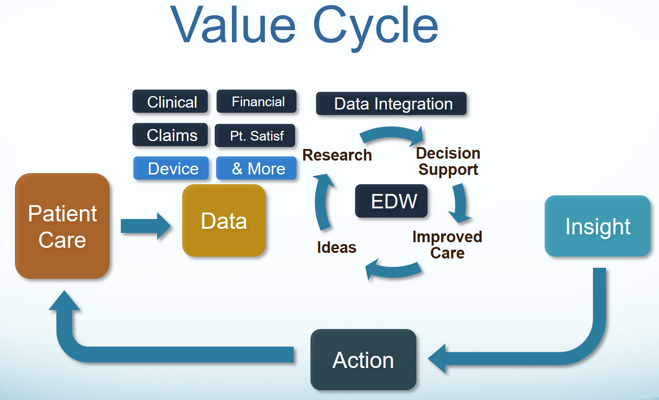
Why is FHIM Valuable Deep Dive?
Aligned FHIM, CIMI, SOLOR and EHR-S FM can specify consistent semantically computable-data, across different platforms, which are consistent and requirements traceable.
Notes:
Video was updated2018-12-27. Audio Script last updated 2019-03-25.
Paragraph outline numbers correspond to automation steps.
Training Objective: “Why is FHIM Valuable Deep Dive?” training video focuses on the FHIM value proposition.
- The FHIM Federal Health Information model delivers a vetted requirements information view of the highly complex and ever changing healthcare land-scape; where, FHIM has been created, verified and validated through over ten years of collaborative Modeling and Terminology meetings with the participation of federal, commercial and academic healthcare Subject Matter Experts.
- Second, the FHIM provides a single point of reference to ensure consistent updating of healthcare information requirements based on changes in healthcare laws, regulations, policies, and standards.
- Third, the FHIM offers the deep and consolidated meta information and tools needed in the coming years to build solutions that save cost and time and which positively impact patient safety and quality of care.
- Since 2016, the FHIM team has been working with the HL7 CIMI clinical information model initiative, Clinical Quality and Decision Support, Patient Care, Public Health, devices, SOA Service Oriented Architecture, vocabulary and EHR workgroups and the HSPC SOLOR SNOMED extension for LOINC and RxNorm initiative. Collectively they have defined a holistic approach to interoperability, to better support the 21st Century Cures Act. HL7 CIMI-compliant FHIM, with SOLOR terminology bindings to improve standard and consistent shared interoperable quality healthcare data. When EHR System Functional Model referred to as EHR-S FM are mapped to FHIM to specify objects. These objects can be constructed into reusable SOA Service Oriented Architecture API application program interfaces and components suitable for service oriented platform run-time environments and user interfaces.
- Value Proposition-1: FHIM, CIMI and SOLOR compliant domain-specific clinical Archetypes, clinical statement Patterns and detailed clinical models with clinical and implementation context-specific datatypes and value sets, simplify implementers’ and clinical informaticists’ tasks. A reference archetype is a domain’s generic superset of attributes, refined into sub-domain patterns and . ultimately refined into specific DCM detailed clinical models. Also note that healthcare and the bulk of FHIM content is international. However, US standards, such as RxNorm, are used, when International standards are not available.
- Value Proposition-2: Consistency across Implementations: where, FHIM, CIMI, EHR-S FM and SOLOR logical specifications can improve platform specific implementation models, such as HL7 FHIR, C-CDA and V2 message interoperability.
- Value Proposition-3: Minimize mapping costs and mapping errors; where, consistent semantics-and-granularity from FHIM and CIMI structures with SOLOR terminology bindings of value-and-code sets can maintain clinical meaning across data-sharing applications.
- Value Proposition-4: Model Driven Development, maintenance and Reuse of Service Oriented Component Based Architectures enable the faster construction of higher quality and lower cost systems and mobile applications; where, these faster, better, cheaper SOA APIs and components can increase value across the entire healthcare IT land-scape.
- Value Proposition-5: Better Outcomes, including
* happier and healthier patient and happier and more effective; healthcare providers; where,
* Quality shared data improves Learning Health Systems’ analytics, reasoning and decision support system algorithms
+ Improve the quality and safety of healthcare and decrease the cost of healthcare.
+ These Quality improvements Enable faster benefits management and
+ Higher patient quality of care and patient safety at lower cost resulting in
+ the entire healthcare ecosystem being more efficient and effective.
+ Model driven architecture, development and sustainment enables consistent and requirements traceable audit-ready SOA service oriented architecture traceability to legislation, regulations, policies and standards.
The YouTube “FHIM Training Channel” contains related videos.
End of this Training Video.

Slide 6
Where are FHIM’s Collaboration Websites?
FHIM GitHub https://github. com/FHIMS
FHIM Models https://github. com/FHIMS/FHIM
FHIM Documents https://github. com/FHIMS/FHIMDocuments
FHIM UI https://github. com/FHIMS/fhimUI
FHIM Backup https://github. com/FHIMS/FHIMBackup
FHIM Website www. FHIMS. org
FHIM Model-Diagrams http://www. fhims. org/content/420A62FD03B6, root. html
FHIM Fact Sheet http://www. fhims. org/docs/FHIM, Fact, Sheet. pdf
FHIM Attributes http://www. fhims. org/docs/FHIM, DataElements, AllClasses. xlsx
FHIM FAQ http://www. fhims. org/background. html
FHIM Guidelines http://www. fhims. org/about. html
FHIM Training Videos: https://www. youtube. com/channel/UCpVPMpQ_A95epsSNUvlvPGQ
Notes:
Video was updated2018-12-24. Audio Script last updated 2019-03-25.
Paragraph outline numbers correspond to automation steps.
Training Objective: “Where are FHIM’s Collaboration Websites Deep Dive” training video enumerates where key FHIM artefacts can be found.
- In the context of FHIM development by a virtual team of modelers and subject matter experts participating in teleconferences and strategic face-to-face meetings, this video answers the operative question “Where are the FHIM Team’s repository, website and training materials?
- FHIM was developed with U. S. Federal government funding and is freely available and free to use. A Creative commons documentation license and/or Apache 2 software license is suggested for FHIM follow-on use.
- GitHub is the official FHIM open source repository; where,
* You will be asked to establish a login, so you can contribute comments and content; but, You do NOT need to login for viewing and downloads.
* We appreciate your setting up a login so we can know who is using FHIM.
* We would also appreciate your sharing testimonials on how you use FHIM and its value to you or your organization.
- The FHIM website publishes the most current GiTHub FHIM content.
The YouTube “FHIM Training Channel” contains related videos.
End of this Training Video.

Slide 7
Who’s on the FHIM Team? Deep Dive
OS/ONC Contracting Manager: Sherilyn. Pruitt@hhs. gov
OS/ONC Technical Manager: Avinash. Shanbhag@hhs. gov
Project Manager: 'Steven Wagner’ SWagner@Apprioinc. com
Modelling SME-Facilitator: ‘Stephen Hufnagel’ Shufnagel@apprioinc. com
Modelling Lead: Galen. Mulrooney@JPSys. com
Vocabulary Lead: Jay. Lyle@JPSys. com
Tooling SME: Sean. Muir@jkmsoftware. com
Clinical SME: 'Robert McClure MD' rmcclure@mdpartners. com
FHA PM Representative: 'Cait Ryan' cryan@irishealthsolutions. com
FHA NIEM Representative: 'Brian Handspicker' bhandspicker@irishealthsolutions. com
Notes:
Video last updated 2018-12-25. Audio Script last updated 2019-03-25.
Paragraph outline numbers correspond to automation steps.
Training Objective: “Who is on the FHIM Team Deep Dive” training video identifies the key FHIM Team points of contact, their roles and their organizations.
- Since 2008, the FHIM Federal Health Information Model was sponsored by the U. S. Department of Health & Human Services (HHS) Federal Health Architecture (FHA).
- In 2004,the FHA office was established as an Office of Management and Budget E-Government Line of Business.
- The FHA office reached out to more than 20 federal agencies to advance the national health IT agenda by bringing together the decision makers in federal health IT for inter-agency collaboration on health information exchange (HIE),.
- FHIM’s goal is enhanced interoperability among federal health IT systems and efficient coordination of shared services.
- The FHA office also supported federal agency adoption of nationally-recognized standards, published in the Interoperability standards Advisory (ISA) and policies published in the Federal Register for secure health information exchange.
- FHA and its programs are being sunset around 2020; where, FHIM is currently managed by the Office of the National Coordinator for Health Information Technology.
- IRIS Healthcare Solutions is a contractor supporting the FHA program office.
- App-preeo Inc is a contractor specifically supporting the FHA’s FHIM program.
- J P Systems, J K M Software and MD Partners are App-preeo sub-contractors supporting the FHIM program.
The YouTube “FHIM Training Channel” contains related videos.
End of this Training Video.

Slide 8
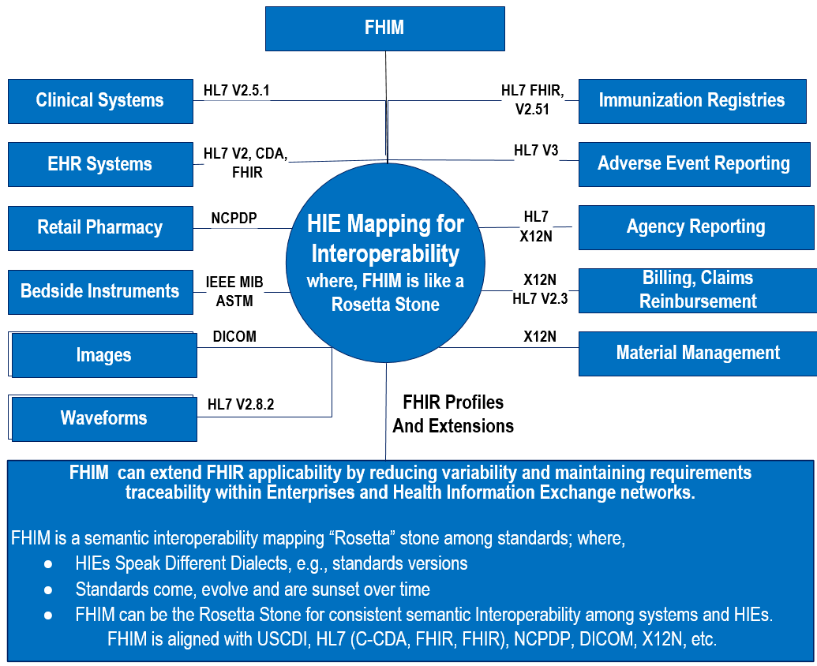
FHIM in a Nutshell … FHIM-HIE Rosetta Stone Analogy
Notes:
Video last updated 2019-03-10. Audio Script last updated 2019-03-25.
Paragraph outline numbers correspond to automation steps.
Training Objective: “FHIM in a Nutshell” gives an “elevator speech,” which concisely describes FHIM to peak the audience interest in learning more about FHIM.
The main FHIM Federal Health Information Model purpose is to manage objects and their relationships at a conceptual level, independent of any specific implementation or transport protocol. Where, HL7 FHIR, C-CDA or V2 implementation guide data models include the implementation-and-protocol specific details such as the FSD FHIR Structure Definition rules that specify how to map managed objects onto lower-level protocol constructs.
Real World H-I-E data-sharing standards Versioning-Challenges include:
- Almost all users adopt an earlier version of a standard; thereby creating a dee facto standard.
- For years after a standard is approved there are systems that still only use previous versions.
- As an example, at CDC, Meaningful Use requires HL7v2. 5. 1, which is a broadly adopted dee facto standard version, even though HL7v2. 8. 2 is the latest v2 Messaging Standard.
- Consider that, HL7v3 has been under development since 1996, and FHIR is 10 years into its development and standardization, but, ninety five percent of US healthcare organizations currently still use HL7v2.
Key FHIM project accomplishments, since its 2008 inception include:
- FHIM is like a semantic interoperability “Rosetta” stone among standards; where,
H-I-E Health Information Exchanges speak different dialects known as standards versions, resulting from standards evolving and being sunset over time.
- As an example, FHIM can derived consistent FHIR and C-CDA artefacts used within and among H-I-E networks; where, consistent data sharing architectures can improve seamless interoperability among:
* EHR and ancillary systems, such as lab, imaging, pharmacy.
* EHR systems and H-I-E networks.
* Multiple H-I-E networks forming regional and Nationwide Health Information Networks called N-HINs.
* ONC TEFCA Trusted Exchange Framework and Common Agreement Qualified HINs called Q-HINs.
- FHIM is a logical information model intended to be constrained to specify one or more implementation data models, such as HL7 FHIR, C-CDA and V2 profiles and extensions.
- FHIM SMEs have curated and published clinical data value and code sets for the NLM V-SAC; where, FHIM aligns terminology and value sets across multiple standards, such as HL7, X12N, NC-PDP and DICOM.
- FHIM is a healthcare clinical information requirements repository and data dictionary covering 30+ clinical domains; where, FHIM can align EHRs and H-I-E networks.
- FHIM is useful by itself. FHIM used with CIMI, EHR-S FM and SOLOR, can result in faster, better, cheaper service oriented architectures for enterprises and H-I-E Health Information Exchanges.
- Where, SOA Service Oriented Architecture can positively influence Patient Safety, Quality of Care and Cost with audit-ready tested reusable HL7 FHIR, CDA and V2 APIs, S-O-A components, Services and platforms. Audit ready implies a requirements-traceable SAIF Service Aware Interoperability Framework, discussed in a separate FHIM Training video.
FHIR is the H-I-E future wave, so why not leap to the future?
First, FHIR is not yet complete, where, even HL7v3 is still developing to the clinical maturity of HL7v2.
Second, practicality dictates continued legacy system use as standards come and go over time, for example:
ASN1 to XSD to J-SON and so on.
O-S-I model Level 7 to HL7v1 to HL7v2 to HL7v3 to HL7 FHIR and so on
ACRONYMS
- FHIM is the Federal Health Information Model sponsored by the US Health and Human Services Office of the National Coordinator.
- CIMI is THE HL7 Clinical Information Model Initiative with industry, government, academic and professional society HL7 CIMI workgroup participants.
- EHR-S FM is the HL7 EHR System Functional Model with industry, government, academic and professional society HL7 EHR workgroup participants.
- SOLOR IS THE HSPC Healthcare Services Platform Consortium S-N-O-M-E-D extension for LOINC and RxNorm and is led by the V-A.
- V-SAC is the National Library of Medicine Value set Authority Center.
The YouTube “FHIM Training Channel” contains related videos.
End of this Training Video.
ADDITIONAL MATERIAL (NOT USED)
- Discussed separately, FHIM, CIMI, SOLOR and EHR-S FM together can extend HL7’s FHIR, CDA and V2 service oriented architecture applicability by reducing variability and maintaining audit-ready requirements and policy traceability across Enterprise components, platforms, APIs, services and H-I-E networks.

Slide 9
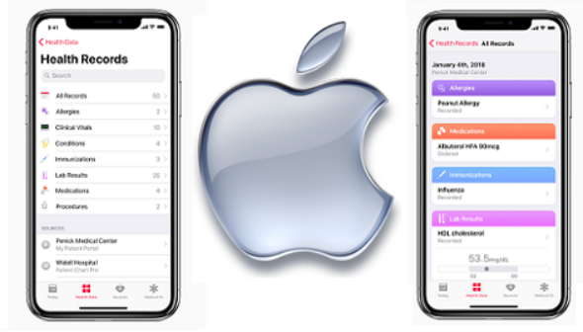

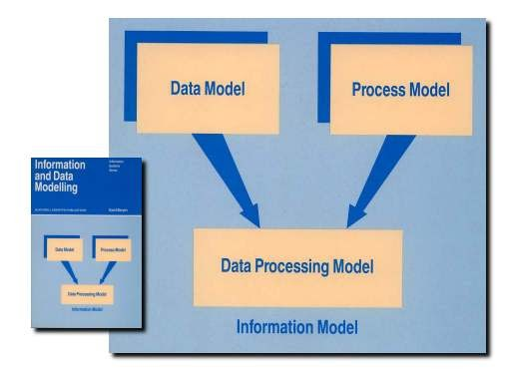

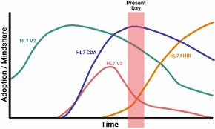
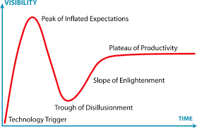
FHIM on FHIR
FHIR
Clinical Goal: Improved quality of life. Technical Objective: Patient Safety, Quality of Care, Lower Cost value proposition from well-tested reusable FHIR APIs, SOA components and services, which use FHIM to make FHIR consistent and requirements traceable.
FHIM
FHIM
Notes:
FHIM on FHIR
Video last updated 2019-04-08. Audio Script last updated 2019-04-08
Paragraph outline numbers correspond to automation steps.
TRANSCRIPT:
1. Training Objective: This “FHIM on FHIR” discusses why FHIM and FHIR alignment is mission essential to meeting the clinical goal “to help people live the healthiest lives possible” and the technical objectives “to improve health IT value by improving patient safety and quality of care, while reducing costs”.
2. Start 0:20: Discussion: 2018 blog posts from the National Coordinator for Health Information Technology highlight the importance of application programming interfaces (APIs) and how these APIs fit into the 21st Century Cures Act’s implementation.
- An Oct 2018 ONC Health IT Buzz report, by Steven Posnack and Wes Barker, shows that the United States (US) might be at a turning point when it comes to the adoption and implementation of the Health Level Seven (HL7®) Fast Healthcare Interoperability Resources (called FHIR®) standard in health information technology (health IT).
- In their analysis, around 32% of the health IT developers were using FHIR, specifically, FHIR Release-2, for certification requirements.
- Nearly 51% of health IT developers appear to be using a version of FHIR combined with the OAuth 2. 0 industry-standard protocol for authorization.
- The analysis included vendors that have a large market share, such as Allscripts, Cerner, Epic and MediTech.
- They found that almost 87% of hospitals and 69% of Merit-based Incentive Payment System (MIPS) eligible clinicians are served by health IT developers with products certified to a FHIR version.
- Much work remains to be done to mature FHIR standards in the transition from FHIR standards development to wide spread operational use of FHIR.
Start 2:03 3. Problem: Unfortunately, FHIR data-quality is in the Gartner hype-cycle “trough of disillusionment”. Where, there are over 10 thousand published ad-hoc FHIR profiles and extensions, which are often inconsistent and lack requirements traceability.
Start 2:21 4. As a recent example, in August 2018, Apple, Amazon, IBM, Microsoft and Salesforce announced they would work together to drive common standards for exchanging health information.
- This announcement was after Apple had already launched its FHIR-compliant Health Records feature in an iOS 11. 3 firmware update.
- Now, third-party developer apps can let iPhone users share health data using FHIR.
Start 2:56 5. The Recommendation is for consistent FHIR service-oriented architecture design time APIs, components and FHIM-based run-time syntactic-and-semantic mappings be deployed across the operational landscape to achieve the clinical goal and health IT objectives.
- In Conclusion The 21st Century Cures Act interoperability path to enlightenment is FHIR built on a FHIM foundation, which defines consistent requirements-traceable FHIM-FHIR implementation patterns, aligned with FHIR core resources and data types. These patterns give implementers a simple FHIM domain-specific reference architecture and patterns, from which to work more efficiently and effectively, while maintaining audit-ready consistency and requirements traceability.
The YouTube “FHIM Training Channel” contains related videos.
4:05 End of this Training Video.
Health IT Buzz URL: https://www. healthit. gov/buzz-blog/interoperability/heat-wave-the-u-s-is-poised-to-catch-fhir-in-2019

Slide 10
FHIM Landscape and Situation
FHA Managing Board members decided that the Open Group will become FHIM’s home. Open Group is industry centric with over 600 member organizations focused on making standards work, e. g. , UNIX, POSIX, TOGAF
HSPC CIIC has the potential to provide FHIM clinical date element curation on the path to FHIR, SOA components and SOA Services Platforms.
HL7® and The FHIR® Foundation has the potential to benefit from FHIM and FHIM based tools. The FHIR® Foundation focuses on implementation and publishing FHIR Structure Definitions (FSDs) on the path to FHIR.
Notes:
Video last updated 2019-03-22. Audio Script last updated 2019-03-25.
Paragraph outline numbers correspond to automation steps.
Training Objective: “FHIM Landscape and Situation” highlights the organizations , which FHIM has a vested interest in, including 1) The Open Group, 2) HL7 and its HL7 FHIR Foundation and HSPC and its CIIC.
FHIM is planned to transition from The US Health and Human Services Office of the National Coordinator to the Open Group in 2019.
The Open Group is leading the development of open, vendor-neutral technology standards and certifications
- The Open Group is a global consortium that enables the achievement of business objectives through technology standards. They have a diverse membership of more than 600 organizations including customers, systems and solution suppliers, tool vendors, integrators, academics, and consultants across multiple industries.
- The Open Group Healthcare Forum is developing a person-centered, value-based approach to understanding the Healthcare Enterprise and the role health IT can play in lowering costs and improving quality and access. Forum Members employ global, collaborative, and cross-disciplinary perspectives. Its work products are innovative, open, and accessible.
- The Open Group works with customers and suppliers of technology products and services, and with consortia and other standards organizations to capture, clarify, and integrate current and emerging requirements, establish standards and policies, and share best practices. Open Group standards ensure openness, interoperability, and consensus.
FHIM may positively impact the the HL7 FHIR Foundation and be positively impacted by the HSPC C I I C Clinical Information Interoperability Council composed of medical professional associations and stakeholders.
HL7 and the FHIR Foundation promotes global adoption and implementation of the FHIR platform standard. The foundation provides information, educational materials, tools, websites, and project support that helps the FHIR community collaborate, align, and expand. The foundation seeks to improve the interoperability of health data with a goal of improving the quality, efficiency and effectiveness of healthcare.
HL7 is dedicated to the development and maintenance of healthcare-related interoperability standards, including FHIR.
The HL7 FHIR Foundation
runs the F-H-I-R dot org web sites on behalf of the FHIR community. F-H-I-R dot org focuses on supporting the use and implementation of the HL7 FHIR standard.
is closely affiliated with Health Level Seven, International (HL7) standards community is a non-profit chartered in the United States as a 501c3,
where F-H-I-R dot org is international in scope.
The Healthcare Services Platform Consortium (HSPC) was founded in 2013 by Intermountain Healthcare, Louisiana State University and the Veteran Administration to refocus how healthcare applications are developed. In the short time since HSPC launched, 270+ contributors have joined the HSPC cause—including leading healthcare and government organizations, healthcare tech vendors and a venture-led group of investors supporting HSPC-centric portfolio companies. As a healthcare provider-led consortium, HSPC applies the same teamwork approach to delivering quality patient care to solving the interoperability challenge. HSPC includes hundreds of active organizations focused on developing a healthcare services platform community that will enable an economy for interoperable applications in a S-O-A and knowledge-enabled model. Through the HSPC interoperable marketplace and services platform, they seek to foster a new level of provider-vendor collaboration and innovation to meet one of the industries’ greatest need to accelerate the creation, sharing and delivery of promising software applications at the point of care.
The HSPC C-I-I-C Clinical Information Interoperability Council serves as a common place to focus on Clinical Data Elements; where, interoperability depends on implementing the same data model across systems. The HSPC and Health Level Seven International convene meetings of clinical societies, academics, and government representatives to plan for achieving full interoperability for healthcare data. These meetings are an extension of the work that began in the clinicians' track of the HL7 Partners in Interoperability. The purpose of the C-I-I-C is to obtain stakeholder commitment to work together to develop and use common data models for clinical data elements.
The YouTube “FHIM Training Channel” contains related videos.
End of this Training Video.
UNUSED CONTENT
The HSPC Core Objective is to support a plug-and-play model for interoperability based on a S-O-A platform with a solid reference architecture. The path to get to a true interoperability model will require a multi-year, phased evolution that includes collaboration between many different stakeholders, using knowledge gained from real-world clinical use cases.

Slide 11
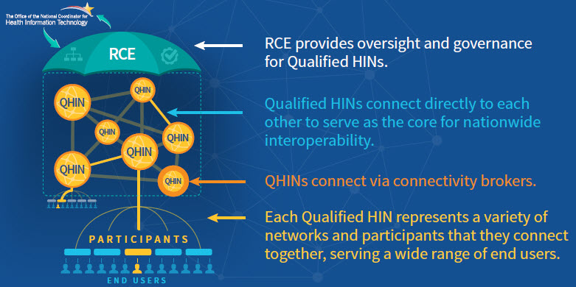
FHIM Profile Builder Maintains FHIR & CDA used within US-CDI and TEFCA
QHIN participants can achieve
interoperability using FPB
Notes:
Video was last updated 2019-02-22 Audio Script last updated 2019-03-25.
Paragraph outline numbers correspond to automation steps.
Training Objective: “FHIM within the US-CDI and TEFCA” discusses FHIM alignment with US-CDI; where, FHIM is ideally suited to support TEFCA, RCE and Q-HINs as a part of the 21st Century Cures Act ONC-HITAC initiative.
The 21st Century Cures Act sets an expectation that all locally stored patient health information will be able to be exchanged electronically. This expectation requires that the industry collectively work towards defining the data that needs to be exchangeable, prioritizing the development of technical standards and implementation guidance to support the exchange of such data, and, ultimately, implementing those capabilities in health IT at the point of care.
- The 2018 Draft US Core Data for Interoperability (US-CDI) and its proposed expansion process aim to achieve the goals set forth in the Cures Act by specifying a common set of data classes that are required for interoperable exchange and identifying a predictable, transparent, and collaborative process for achieving those goals.
- The TEFCA Trusted Exchange Framework and Common Agreement strives to establish a single “on-ramp” for H-I-E networks that will enable providers, hospitals and other healthcare stakeholders to join any health information network and then to automatically connect and participate in nationwide health information exchange.
- TEFCA establishes Q-HIN Qualified Health Information Networks as a vehicle to help facilitate a standardized methodology for H-I-E inter-connectivity, administered by a RCE.
- The RCE Recognized Coordinating Entity will administer TEFCA and will act as the governing body that will operationalize the Trusted Exchange Framework.
- Qualified HINs referred to as Q-HINs are the second cornerstone of TEFCA. Q-HINs are Health Information Networks that agree to abide by the Common Agreement established by the RCE and agree to adhere to the “Minimum Required Terms and Conditions for Trusted Exchange”.
- Q-HINs are a network of HINs that can exchange information with each other and are envisioned as the vehicle for delivering a nationwide health information exchange.
Here, FHIM is ideally situated to help align consistent semantic interoperability among Q-HINs governed by an RCE. FHIM is like a semantic interoperability “Rosetta” stone among standards; where,
- H-I-E Health Information Exchanges speak different dialects known as standards versions, resulting from standards evolving and being sunset over time.
- FHIM derived FHIR artefacts used within industry and Federal Agency H-I-E data sharing architectures improve:
* EHR and ancillary systems, such as lab, imaging and pharmacy interoperability
* EHR systems and H-I-E networks interoperability
* Multiple H-I-E networks forming regional and Nationwide Health Information Networks called N-HINs.
* ONC TEFCA Trusted Exchange Framework and Common Agreement Qualified HINs called Q-HINs.
The YouTube “FHIM Training Channel” contains related videos.
End of this Training Video.

Slide 12
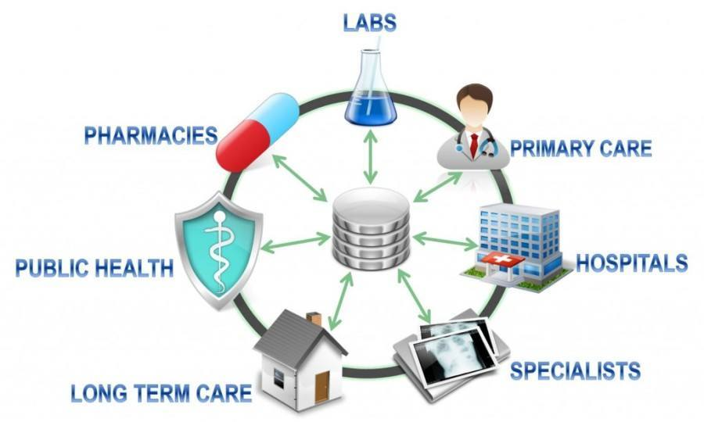
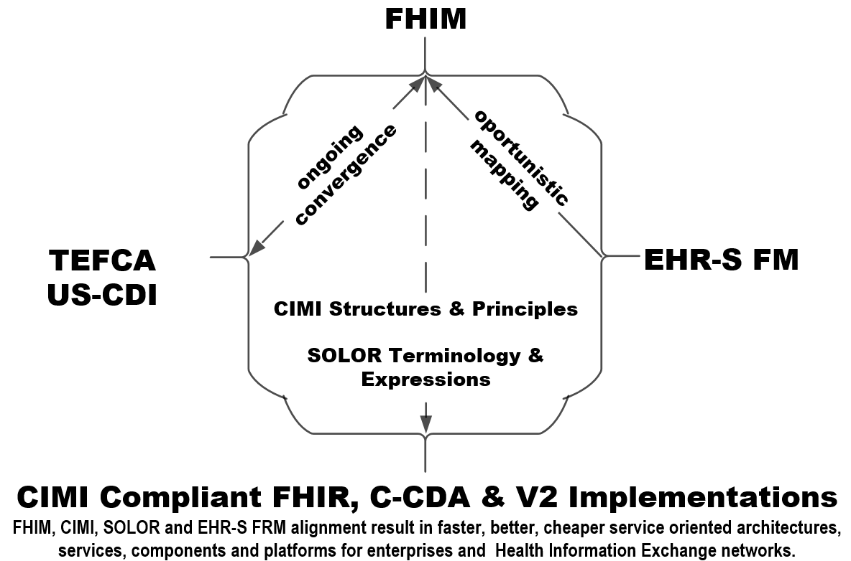
Better Interoperability using FHIM, CIMI, SOLOR and FHIR
Notes:
Video last updated 2019-02-22. Audio Script last updated 2019-03-25.
Paragraph outline numbers correspond to automation steps.
Training Objective: “Better Interoperability using FHIM, CIMI, SOLOR and FHIR” training video highlights how holistic syntactic-and-semantic data-computability and information-interpretability is improved when these initiatives are aligned.
Semantic Interoperability is where the meaning of data can be shared among systems. FHIM, CIMI, SOLOR and EHR-S FM are useful in themselves; but together, they can significantly improve computable semantic interoperability for clinical decision support, analytics and reasoning.
1. FHIM has aligned terminology and value sets across multiple standards, including HL7, X12N, NCPDP, DICOM and more.
2. EHRs and H-I-E networks can be better aligned by using FHIM as a healthcare clinical information requirements repository and data dictionary covering 30+ clinical domains.
3. FHIM has been aligned with the HL7 CIMI, HL7 EHR-S FM and HSPC SOLOR to better achieve the 21st Century Cures Act TEFCA and US-CDI policies and interoperability objective set by ONC.
4. FHIM, CIMI, SOLOR and EHR-S FM alignment result in faster, better, cheaper service oriented architectures and component-based services-platforms for enterprises and Health Information Exchange networks. Patient Safety, Quality of Care, Lower Cost comes from well-tested reusable HL7 FHIR, C-CDA and V2 APIs, S-O-A platforms, components and services.
5. FHIM-CIMI-SOLOR-EHRS FM extend HL7’s FHIR, C-CDA and V2 profile applicability by reducing variability and maintaining requirements traceability within Enterprises and H-I-E Health Information Exchange networks.
FHIM BENEFIT: FHIM is like a semantic interoperability “Rosetta” stone among standards; where,
- H-I-E Health Information Exchange networks speak different dialects known as standards versions, resulting from standards evolving and being sunset and replaced over time.
- FHIM, CIMI, SOLOR, EHR-S FM are useful in themselves; where, derivative HL7 FHIR, C-CDA and V2 artefacts used within industry and Federal Agencies improve:
* EHR and ancillary systems, such as laboratory, imaging and pharmacy interoperability
* EHR systems and H-I-E networks interoperability
* Interoperability among Multiple H-I-E networks forming regional and Nationwide Health Information Networks called N-HINs.
* ONC TEFCA Trusted Exchange Framework and Common Agreement Qualified HINs called Q-HINs.
ACRONYMS
- FHIM is the Federal Health Information Model sponsored by the US Health and Human Services Office of the National Coordinator.
- CIMI is THE HL7 Clinical Information Model Initiative led by Intermountain Healthcare.
- EHR-S FM is the HL7 EHR System Functional Model led by the HL7 EHR workgroup
- SOLOR IS THE HSPC Healthcare Services Platform Consortium S-N-O-M-E-D extension for LOINC and RxNorm led by the V-A.
- V-SAC is the National Library of Medicine Value set Authority Center.
- TEFCA is the ONC Trusted Exchange Framework and Common Agreement.
- US-CDI is the ONC Common Data for Interoperability.
The YouTube “FHIM Training Channel” contains related videos.
End of this Training Video.

Slide 13
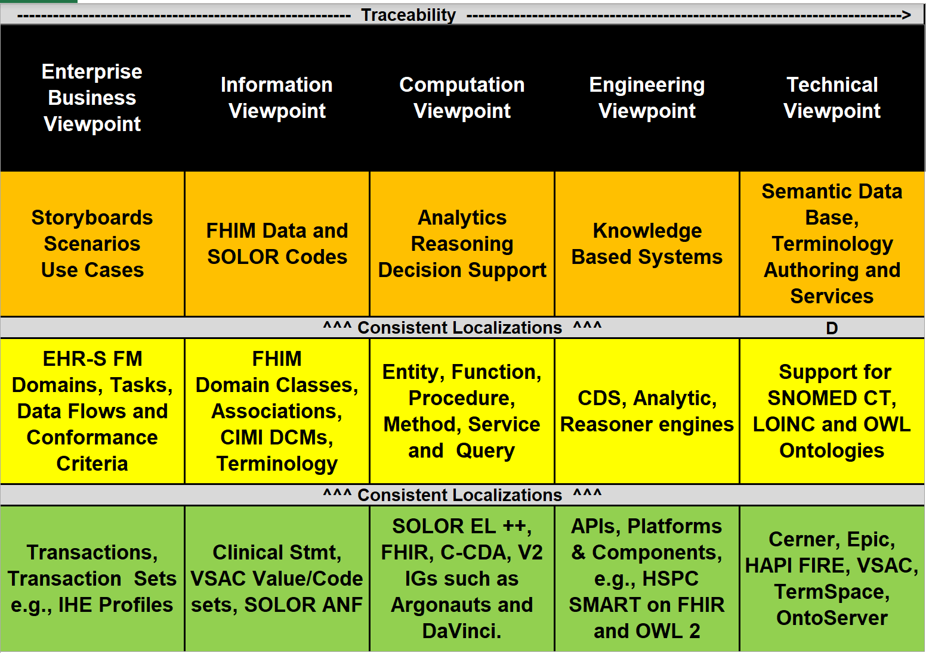
System Engineering use of FHIM
Notes:
Videolast updated 2019-03-09. Audio Script last updated 2019-03-25.
Paragraph outline numbers correspond to automation steps.
Training Objective: “System Engineering Use of FHIM” training video demonstrates how FHIM can contribute within a Service Oriented Architecture (SOA); where, FHIM is interesting by itself; but, FHIM within the HL7 Service Aware Interoperability Framework (SAIF) can help specify SOA components, APIs and platforms.
Using HL7 SAIF, which is based on ISO RM ODP, we can specify construct systems using FHIM, CIMI DCMs, SOLOR Terminology to build faster, better and cheaper software with improved patient value; where, the value proposition is further discussed in other FHIM training videos.
SAIF has conceptual, logical and implementable models, which are each defined for the following viewpoints:
The Enterprise Business viewpoint shows system context and requirements such as information exchanges and reference standards.
The Information viewpoint shows required system data.
The Computation viewpoint shows software system-structure ­­­­­models & APIs.
The Engineering viewpoint shows required systems infrastructure.
The Technology viewpoint is the collection of techniques, skills, methods, things and processes used in the production of systems. Note that each item in the technology viewpoint might have its own ECCF Implementation Guide.
This example contains notional healthcare content to describe an approach to building healthcare interoperability guides for interoperable EHR knowledge-based systems. Note that consistency and traceability should be maintained horizontally and vertically within an ECCF matrix.
Conceptual Computation Independent Model (CIM) describes business context for a system capability, feature or module. For FHIM it describes the who, what, when, where of FHIM data use without specific details.
The Conceptual Enterprise Business Viewpoint includes Storyboards, Scenarios, Use Cases and other ways to describe the key events, actors, pre and post conditions, tasks, activities and information exchanges that occur.
The Conceptual Information Viewpoint includes the shared information among actors for each type of event, task or activity using FHIM information, CIMI structures and SOLOR semantics.
The Conceptual Computation Viewpoint describes the type of data computations to be performed such as analytics, reasoning and decision support.
The Conceptual Engineering Viewpoint describes the type of required system infrastructure; where in this example, we used EHR knowledge Based Systems.
The Conceptual Technical Viewpoint describes the types of required system infrastructure needed to meet the system requirements.
Logical Platform Independent Model (PIM) describes the business requirements for a system capability, feature or module. In the case of FHIM, it describes the specific FHIM-centric information exchange requirements, independent of a particular implementation platform.
The Logical Enterprise Business Viewpoint includes the EHR-S FM domains, tasks, and conformance to describe the requirements conformance criteria for the key actors, tasks, activities and data flows that occur when a system is used. In the case of FHIM, a subset of the EHR-S FM domains, tasks and conformance criteria can be used for a specific system, component or module.
The Logical Information Viewpoint includes the required FHIM domains, classes, associations, CIMI DCMs and data element terminology appropriate to a specific Implementation Guide.
The Logical Computation Viewpoint provides the business requirements for software functions, procedures, methods, services and queries used by the system.
The Logical Engineering Viewpoint gives the business requirements for the system infrastructure, based on the system type such as, for EHR knowledge Based Systems you might include CDS rules, Analytics and Reasoning engines.
The Logical Technical Viewpoint describes the requirements for techniques, skills, methods, things and processes used in the production of components used to construct the system.
Implementable Platform Specific Model (PSM) specifies the business system implementation requirements-specifications for a system capability, feature or module. It specifies the implementation paradigm for FHIM data use, specific to one or more implementation platforms. There may be many PSMs for one PIM.
The Implementable Enterprise Business Viewpoint includes the Transactions and Transaction Sets’ e. g. , I-H-E profiles supporting the actors, tasks and activities and data flows that occur as a system is used.
The Implementable Information Viewpoint includes the Clinical Statements, V-SAC Value and Code sets, SOLOR A N F Analysis Normal Form that support the FHIM domains, their classes, associations, CIMI DCMs and data element terminology specifications.
The Implementable Computation Viewpoint includes the SOLOR E L plus plus descriptive logic, templates FHIR, CCDA, V2 Implementation Guides such as Argonauts and DaVinci, that supports the software functions, procedures, methods, services and queries used by the system.
The Implementable Engineering Viewpoint specifies the APIs, platforms and components, such as HSPC SMART on FHIR components that implement the required system infrastructure, for the type of desired system. As an example, for a knowledge Based Systems you might include CDS rules, Analytics, and Reasoner engines
The Implementable Technical Viewpoint specifies the techniques, skills, methods, things and processes used in the production of components used to construct the system.
ACRONYMS
FHIM is the Federal Health Information Model sponsored by the US Health and Human Services Office of the National Coordinator.
CIMI DCMs are the HL7 Clinical Information Model Initiative Detailed Clinical Models. DCMs may be constrained from FHIM archetypes. CIMI work is led by Intermountain Healthcare.
EHR-S FM is the HL7 EHR System Functional Model and is led by the HL7 EHR workgroup
SAIF ECCF is the HL7 Service Aware Interoperability Framework Enterprise Compliance and Conformance Framework, which is based on the ISO RM ODP International Standards Organization Reference Model of Open Distributed Processing.
SOLOR IS THE HSPC Healthcare Services Platform Consortium S N O M E D extension for LOINC and RxNorm and is led by the Veterans Administration.
V SAC is the National Library of Medicine Value set Authority Center.
The YouTube “FHIM Training Channel” contains related videos.
End of this Training Video.

Slide 14
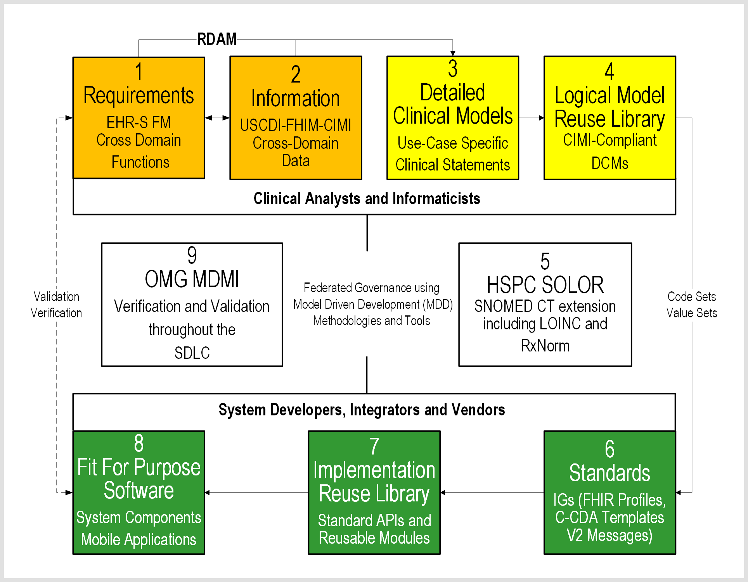
Notional FHIM to FHIR Methodology
Notes:
Video last updated 2019-03-02. Audio Script last updated 2019-03-25.
Paragraph outline numbers correspond to automation steps.
Training Objective: “Notional FHIM to FHIR Methodology” training video walks through a FHIM-based FHIR Model Driven Architecture (MDA) process; where, we start with a use-case model with scenarios, which are refined into a Service Oriented Architecture (SOA) with SOA components and APIs system-design. Automated Model Driven Development (MDD) results in an agile methodology to produce documentation, test, certification and training artefacts.
1. - Organized into EHR-S FM clinical-domain functional conformance-criteria
2. - Aligned with US-CDI-FHIM-CIMI clinical-domain architypes and patterns for findings, orders, procedures, etc.
3. - Where, US-CDI data elements and classes are harmonized within FHIM and FHIM architype patterns are constrained into CIMI logical DCM Detailed Clinical Models to specify
V2, FHIR and C-CDA, etc. structure-definitions bound to SOLOR vocabularies and code sets
Resulting in interoperable and requirements traceable HL7 FHIR, CDA and V2 profile and extension implementation guides, APIs, components & services used for data sharing among learning systems’ analytics, reasoning and decision support systems.
This methodology can positively impacts inconsistent Extraction, Transfer and Load (ETL) processes that put HIN data at risk. Federal Agencies, partners, venders and contractors should incorporate these modern best-practice (standards, methodologies, technologies and tools) to enhance semantic interoperability.
In the slide, we specify a R-DAM Reference Domain Analysis Model in steps 1-2 EHR-S FM System Functional Model with the FHIM Federal Health Information Model enables the formation of a SOA reference model for open distributed processing.
SOA domain-specific cohesive object spheres, of knowledge, activities and influence can maintain conceptual integrity within loosely coupled HIT components; where, context-specific clinical objects of functions and data can be validated by clinical domain SMEs and stakeholders.
In the slide, a clinical analyst and informaticist can bootstrap a new project with
1: EHR-S FM clinical-requirements stated as conformance criteria, mapped to
2: FHIM domain-specific data requirements. This domain data can be constrained to
3: application-specific clinical statements specified as
4: logical CIMI-compliant DCM Detailed Clinical Models, which can be represented as FHIR Structure Definition. DCMs can be bound to
5: SOLOR terminology to specify consistent and requirements traceability
6: Standard I-G Implementation Guides for FHIR profiles, C-CDA templates and V2 artefacts.
Large scale enterprise initiatives can have rigorous development of DCMs by seasoned clinical professionals in steps 1 through 6, resulting in faster, better and cheaper re-usable software components by Healthcare IT developers in Steps 6 through 8. SDLC consistency can be verified by Model Driven Message Interface (MDMI) tools in Step 9 resulting-in improved interoperability from FHIM,CIMI, SOLOR, EHR-FM compliance.
Small scale site initiatives can have individual developers profile or extend step 6: FHIR, CDA or V2 standards OR start with step 7: Reusable Component Libraries to create step 8: Fit for Purpose Software. In step 9: fit-for-purpose systems can be verified, in run-time, to have improved interoperability by maintaining CIMI compliance.
In summary, the notional FHIM, CIMI SOLOR, EHR-S FM data-quality strategy operationalizes service oriented architecture lessons learned to simplify and improve governance, products, processes, and reduce healthcare IT costs. The notional methodology will take time to mature across clinical domains; where, FHIM, CIMI and EHR-S FM collaboration and compliance can positively influence patient safety, care quality and cost value by finding inflection points; where, interoperable products and services efficiently and effectively meet HIT developer and clinical user needs.
ACRONYMS
- FHIM is the Federal Health Information Model SPONSORED BY THE US Health and Human Services Office of the National Coordinator.
- CIMI is THE HL7 Clinical Information Model Initiative and is led by Intermountain Healthcare.
- EHR-S FM is the HL7 EHR System Functional Model and is led by the HL7 EHR workgroup
- SOLOR IS THE HSPC Healthcare Services Platform Consortium S-N-O-M-E-D extension for LOINC and RxNorm and is led by the V-A.
- V-SAC is the National Library of Medicine Value set Authority Center.
The YouTube “FHIM Training Channel” contains related videos.
End of this Training Video.
ADDITIONAL MATERIAL (NOT USED)
TEFCA-USCDI should build upon areas of agreement, in a decentralized way that percolates consensus up, gradually extending and scaling data-use agreements and data-interoperability conformance criteria, as consensus and standards mature. Vendor system conformance testing should be voluntary and QHIN compliance certifications should have periodic updates. This is key to evolving standards adoption and enhanced QHIN interoperability on the path to learning healthcare systems. The success metric is scalability among healthcare domains, sub-domains and stakeholder uptake.
CONCLUSION
The Interoperability Conundrum is immutable inconsistencies across standards; where,
data (granularity, pre/post coordination, types, value/code sets, metadata) variations
negatively impacting Healthcare IT value (patient safety, care quality, cost).

Slide 15
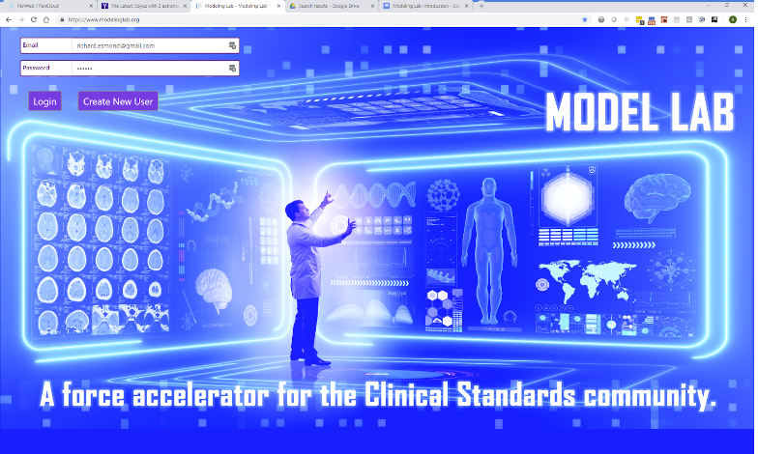

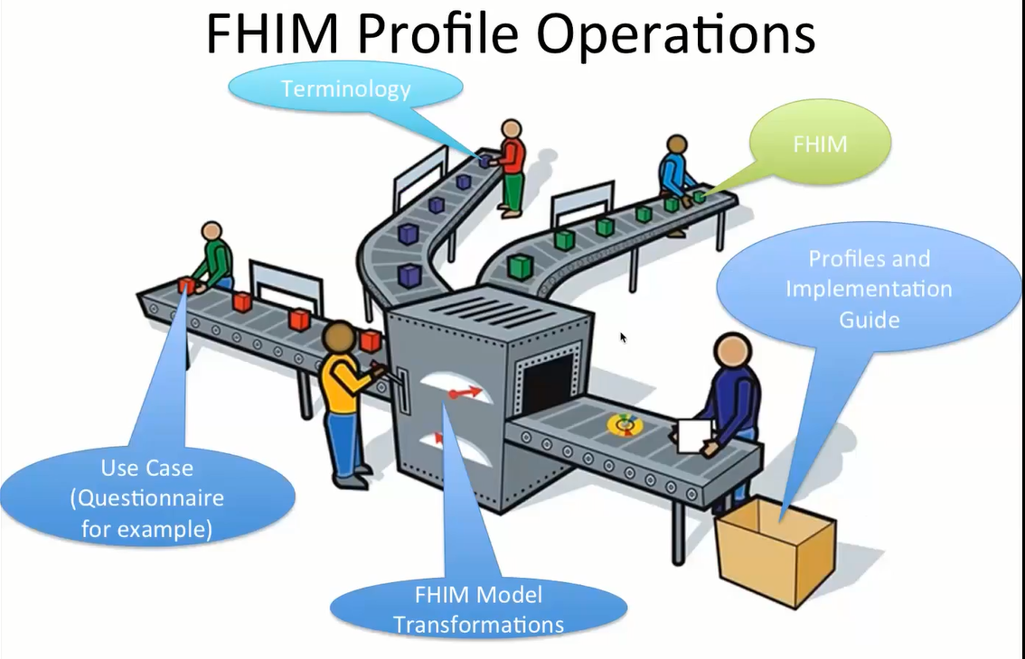
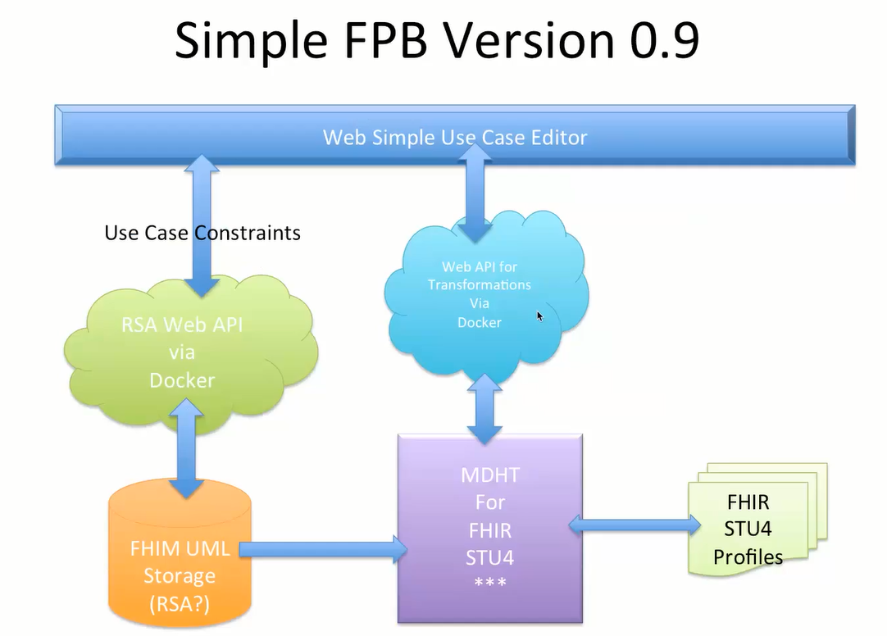
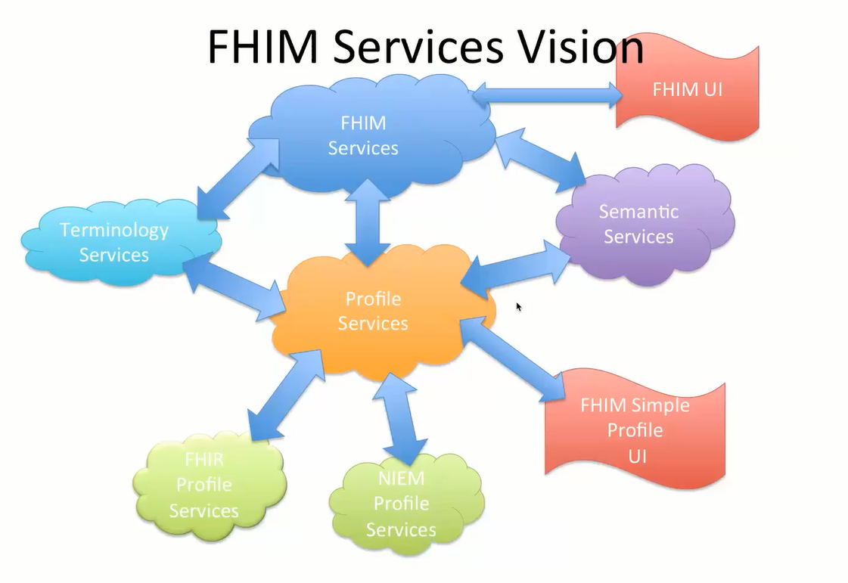
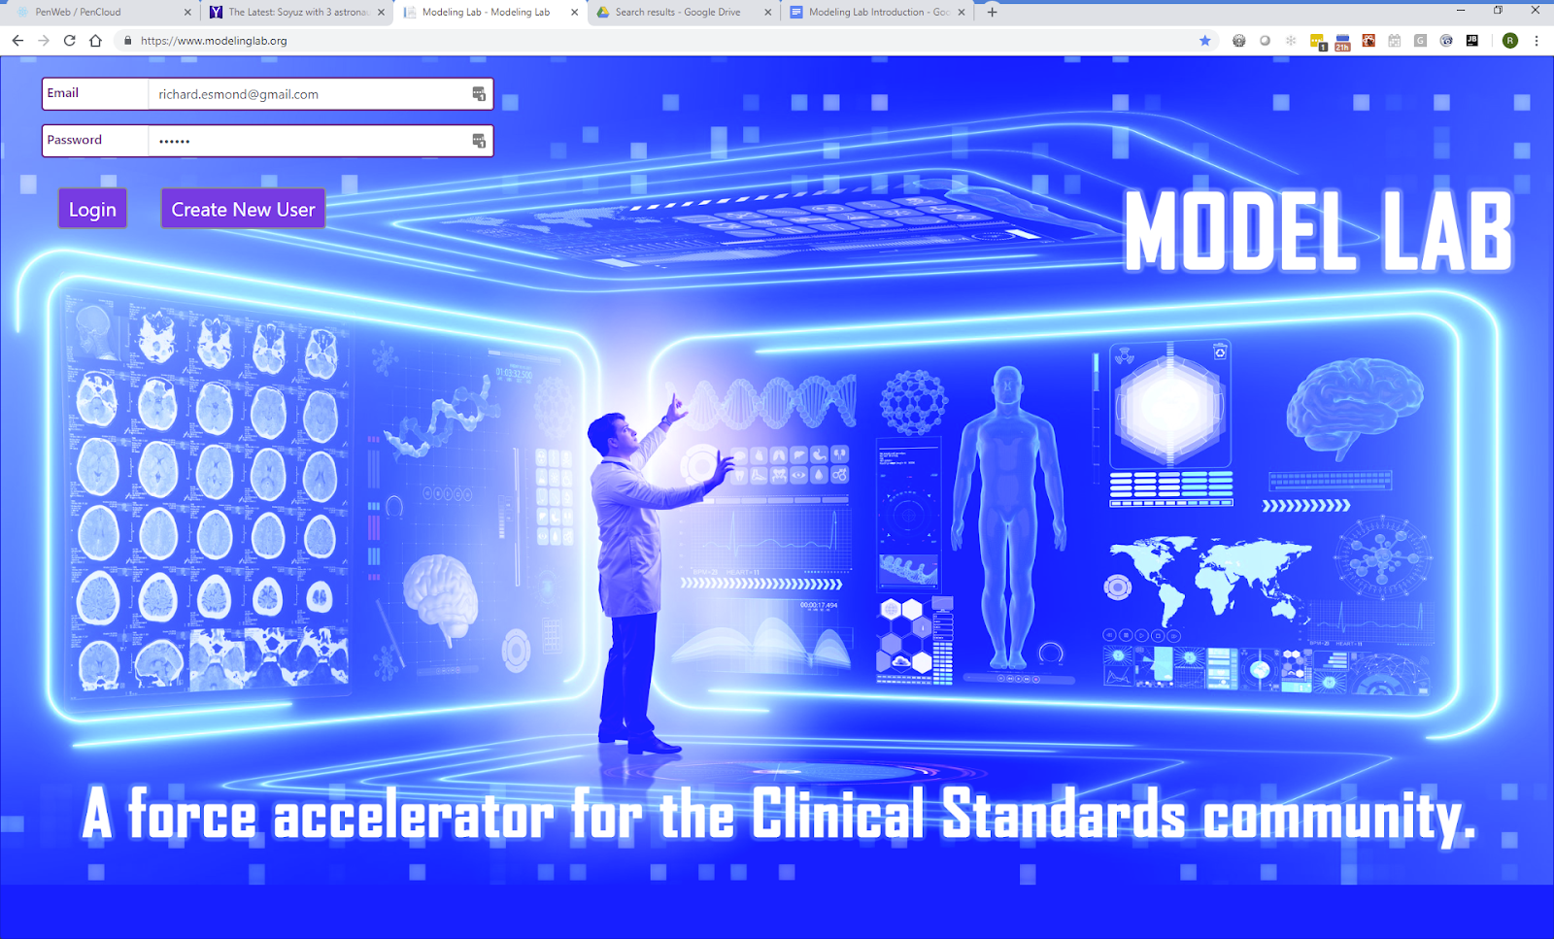
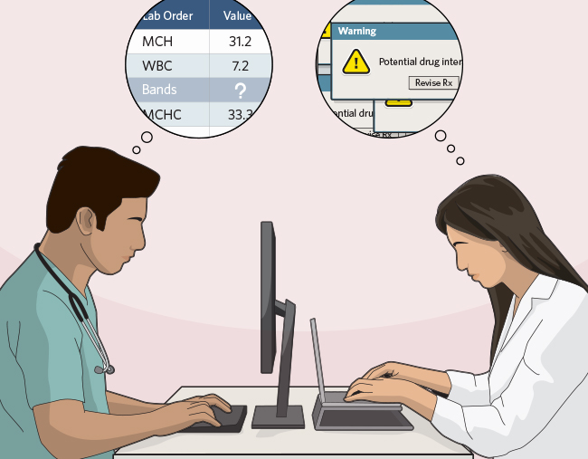

FPB Web 2. 0 Solution Architecture Constructed as a Health IT SOA
Clinician
Workbench
Standards Infusion
`
Run Time
Implementations
FHIM
Terminology
FHIM
Patterns
API
Run Time
HDD and Terminology
API
Design Time
FPB-MDHT
FHIM Profile Builder
Run Time
MDMI
Translation
API
API
API
Design Time
Model
Repository
API
`
API
API
Standards Infusion
FHIR
Resources
CDA
Templates
Run Time
Implementations
IG
FHIR, CDA, etc.
See Notes Page
Notes:
See separate word document

Slide 16
FHIM-MDHT Interoperability Specification Tooling
ACRONYMS
ADL is Architecture Description Language.
DCM is Detailed Clinical Models.
DSL is Domain Specification Languages
FSD is FHIR Structure Definition
SIGG is Standards Implementation Guide Generator
SOLOR is SNOMED extension for LOINC and RxNorm
Standards Infusion
`
ACRONYMS
C-CDA is Consolidated Clinical Document Architecture
FHIR is Fast Health Interoperability Resource (FHIR)
MDHT is Model Driven Health Tool
MDMI is Model Driven Message Interface
NIST is National Institute for Standards and Technology
ONC is Office of the National Coordinator for Health IT
Terminology
Reference
Models
SIGG
FHIM Domain
Patterns
Design Time
Model Repository
Design Time
MDHT
DCMs and FSDs
Run Time
MDMI
Translator
DCMs
FSDs
Standards Infusion
FHIR
Resources
CDA
Templates
IG
FHIR, CDA, etc.
See Notes Page
Notes:
FHIM-MDHT Interoperability Specification Tooling
Video last updated 2019-03-28. Audio Script last updated 2019-03-25.
Paragraph outline corresponds to automation sequence.
Training Objective: “FHIM-MDHT Interoperability Specification Tooling” training video shows how FHIM-based MDHT can improve and simplify the Standards Implementation Guide Generator (SIGG) process.
Potentially tedious and error prone, the SIGG process can be done manually. SIGG starts with FHIM domain “archetype” patterns, which are constrained, based on a use-case, into Detailed Clinical Models called (DCMs). DCMs can be specified as FHIR Structure Definitions (FSDs) or specified in other Domain Specification Languages (called DSLs), such as CIMI Architecture Description Language (ADL).
DCMs can have SOLOR SNOMED extension for LOINC and RxNorm value or code sets bound to them.
And, DCMs can be fully CIMI compliant by following CIMI principles, which require DCMs to be derived from the FHIM-CIMI Reference Model architype patterns, being iso-semantic with a CIMI preferred post-coordinated form and being represented in CIMI ADL.
Start 1:16: Model Driven Health Tool (MDHT), using FHIM, can automate SIGG. MDHT can infuse standards while generating logical models and implementation guide versions. Although MDHT is not limited to HL7 standards, current focus is on designing and implementing HL7 Fast Health Interoperability Resource, referred to as F-H-I-R and pronounced FIRE, and HL7 Consolidated Clinical Document Architecture, referred to as C-CDA implementation guide profiles and extensions.
- HL7 FIRE APIs are mandated by the 2020 ONC and CMS Information Blocking rule, under the 21st Century Cures Act.
- HL7 C-CDA templates are mandated the 2016 ONC and CMS Meaningful Use certification requirements for Electronic Health Record (EHR), under The 2009 American Reinvestment & Recovery Act (ARRA) including the "Health Information Technology for Economic and Clinical Health (HITECH) Act".
ONC and NIST use MDHT generated Java runtime libraries of C-CDA standard UML models for certification testing and verifying that CDA XML documents satisfy all requirements under the Meaningful Use rules.
In more depth, MDHT is a suite of UML tools; where, models are represented in XML format. MDMI supports the model driven design and implementation of healthcare standards. MDHT delivers an open source standard object-oriented alternative to proprietary development methodologies and tooling, used to specify and implement most healthcare industry interoperability standards.
MDHT can best be used by 1) authors of healthcare industry interoperability standards, 2) certification or testing authorities, and 3) software developers that implement adapters and applications that produce and consume healthcare data.
MDHT uses UML use cases, as input, to scope each transformation to allows users to remain focused on the clinical content and not be overwhelmed by modelling formalisms.
MDHT has constraint-based editing tools, specialized terminology systems editing tools, and transformation tools to maintain runtime Java libraries that support application development and constraint validation testing.
MDHT specifies healthcare-specific UML interoperability profiles, XML and Java in a form suitable for direct use by implementer or for publication by standards development organizations (SDOs).
Start 5:35: A Design Time Model Repository is used to configuration manage healthcare FHIM Domain Archetype Patterns, DCMs, FSDs and IGs; where, they can be peer reviewed, maintained and published for software component developers and system interface implementers to use. MDHT or HL7 FHIR tools can convert FSDs into FHIR or CDA, profile or extension IG Implementation Guides. The IGs can be used, as is, or they can be balloted and standardized and curated at HL7 for future reuse by component developers and interface implementers.
Start 6:25: Model Driven Message Interface (MDMI) tool can use the design time Model Repository to specify semantically correct translations from one message-serialization standard to another. MDMI supports a computable representation of the semantics within each standard to harmonize data sharing among heterogeneous systems, different standards and varying standards versions. MDMI is discussed separately.
The YouTube “FHIM Training Channel” contains related videos.
End of this Training Video.
ACRONYMS (1)
ADL is Architecture Description Language.
DCM is Detailed Clinical Models.
DSL is Domain Specification Languages
FSD is FHIR Structure Definition
SIGG is Standards Implementation Guide Generator
SOLOR is SNOMED extension for LOINC and RxNorm
ACRONYMS (2)
C-CDA is Consolidated Clinical Document Architecture
CMS is Center for Medicare and Medicade
FHIR is Fast Health Interoperability Resource (FHIR)
MDHT is Model Driven Health Tool
MDMI is Model Driven Message Interface
NIST is National Institute for Standards and Technology
ONC is Office of the National Coordinator for Health IT
UNUSED CONTENT
Finally, the MDHT tooling environment includes model transformations that leverage Eclipse Modelling Framework (EMF) and Object Constraint Language (OCL) to generate Java code used by healthcare implementers; where, the core EMF framework includes a meta model called (Ecore) for describing models and runtime support including change notification, persistence support with default XMI serialization, and an efficient reflective API for generically manipulating EMF objects.
Why don't we simply use general-purpose UML tools? What makes healthcare information models different?
- First, Constraint-based modeling approach; where, most healthcare standards create a "reference model" and then define templates, archetype patterns and profiles, with constraints on one or more reference model classes. For example, in the C-CDA implementation guide, a Vital Sign template includes constraints on the base CDA Observation class. MDHT models this template using a UML subclass, but many constraints cannot be represented using standard UML, especially terminology constraints for coded attributes. MDHT includes specialized constraint editing tools that support application developers and constraint validation.
- Second, Clinical Terminology used for creating clinical information models usually involves searching very large and complex terminology systems, such as SNOMED CT or LOINC ontologies, creating or evaluating value or code sets, and assigning these as constraints on UML class attributes. MDHT includes specialized editing tools for using these terminology systems, and transformations to runtime Java libraries that support application developers and constraint validation.
- Thirdly, Users of modeling tools are often clinical informatics specialists, not familiar with UML or software engineering; where, the MDHT modeling tools enable users to edit and review clinical information models, with terminology value or code set constraints. MDHT users can remain focused on the clinical content and not be overwhelmed by modelling formalisms.

Slide 17
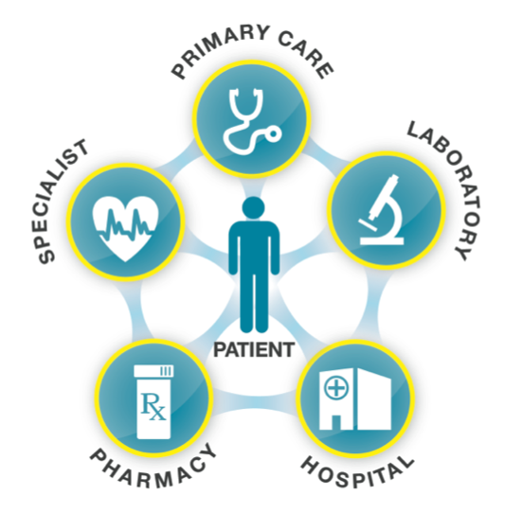
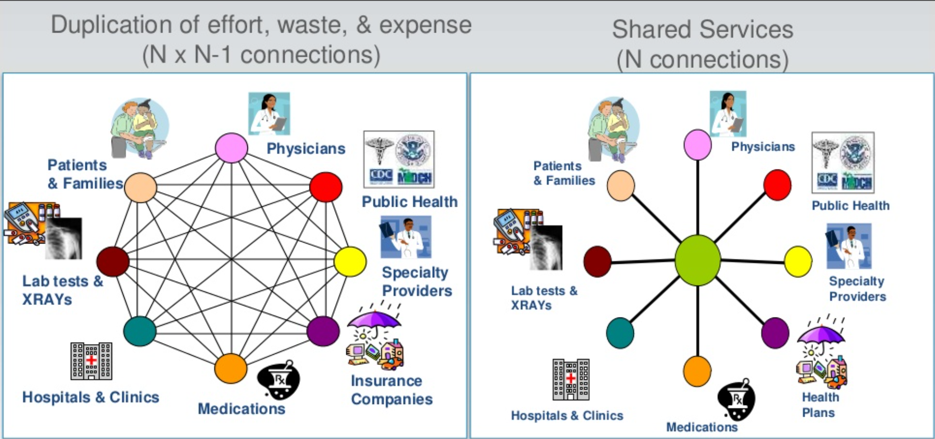
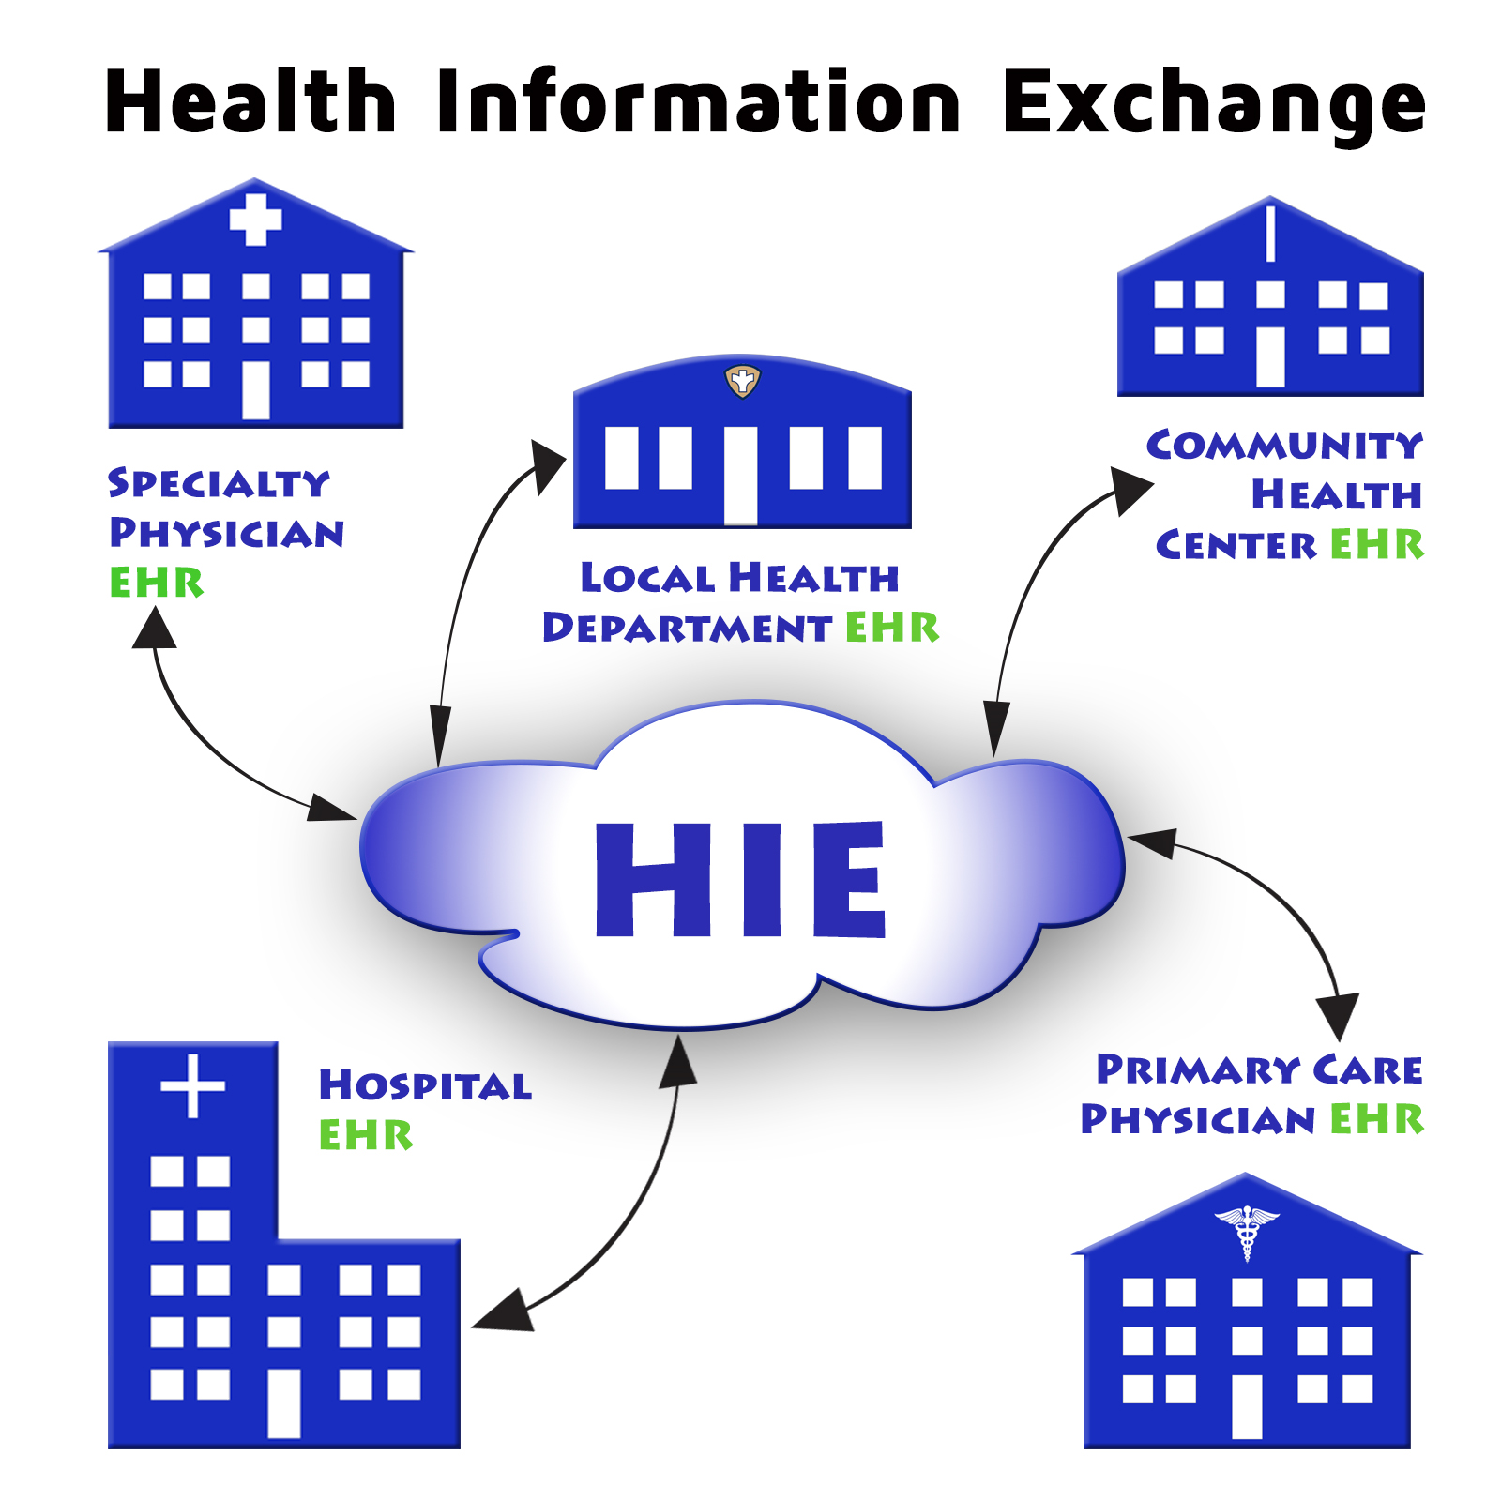
FHIM-MDMI Run-Time Translation Tool
Implementations
In summary, run-time MDMI type interoperability stack middleware is mission-essential for
Collection, Communication, Aggregation and Interpretation of patient data to accelerate secondary uses in public health, disease surveillance, post-approval monitoring, and patient-centered outcomes research.
Health-Related Services including telecare, clinical decision support, research, and quality measurement, improving healthcare access, quality, and uniformity.
Improved Care Coordination, Reduction of Medical Errors, and Decreased Costs resulting in healthier and happier lives. realized by patients, clinicians, and the public `
Standards Infusion
`
Implementations
Terminology
Reference
Models
NCPDP
Java &
JSON
Java &
JSON
NCPDP
DICOM
X12
SIGG
DICOM
X12
FHIM Domain
Patterns
Health Data Dictionary and Terminology
Health Data Dictionary and Terminology
Design Time
Model Repository
Design Time
MDHT
DCMs and FSDs
Run Time
MDMI
Translation
Run Time
MDMI
Translator
Design Time
Shared Model
Repository
Run Time
MDMI
Translation
Design Time
Shared Model
Repository
DCMs
FSDs
Standards Infusion
Implementations
Implementations
FHIR
Resources
CDA
Templates
IG
FHIR, CDA, etc.
V2
SOLOR
ANF
CDA
CCA
FHIR
V2
SOLOR
ANF
CDA
CCA
FHIR
SEMHIE accelerated the Social Security disability insurance claims process from 457 days, on average, to approximately six hours.
Notes:
FHIM-MDMI Run-Time Translation Tool
Video last updated 2019-03-31. Audio Script last updated 2019-03-31.
Paragraph outline numbers correspond to automation steps.
1. In the separate FHIM-MDHT Model Driven Healthcare Tooling Vision video we showed how FHIM based MDHT can improve and simplify the design-time SIGG Standards Implementation Guide Generator process. Training Objective: “FHIM-MDMI Run-Time Translation Tool” training video discusses how FHIM use within MDMI can improve and simplify the heterogeneous system information-sharing data-translation process.
- The Situation is that run-time semantic data mapping and structural transformations are the universal approach to improve intra-and-inter HIE Enterprise Health Information Exchange network interoperability, across heterogeneous systems, standards and standards versions.
- This is especially true when ancillary systems, sub-networks and components are added across time, across clinical domains and across enterprises.
2. Start at 1:37: Any industry, including healthcare, that has “make it fast, deal with high volume and run-time translation requirements can benefit from a tool like the Object Management Group’s Model Driven Message Interface tool called MDMI.
- MDMI uses FHIM as its canonical computable representation, referred to as its referent index. The referent index is mapped to each alternative information exchange representation to harmonize data sharing among heterogeneous systems, different standards and varying standards versions. MDMI’s setup can use the MDHT design-time Model Repository to specify semantically correct translations from one message serialization to another.
- This can be a practical way to achieve data sharing interoperability within and among distributed SOA communities of independent enterprises and legacy systems; where, each participant builds and maintains one map of their data elements to the MDMI referent index.
MDMI decomposes each data exchange into its syntactic elements and semantic elements. Where, MDMI maps the semantic data terminology elements to uniquely identified business data concepts, in the FHIM data dictionary. This design time referent index mapping makes the MDMI run-time translations fast; where, FHIM is acting as the MDMI semantic translation Rosetta stone.
- We must be cautious because one-to-one semantic mapping can be confounded by differences in data types, differences in pre-and-post coordination, differences in concept-granularity, plus lack of data provenance consistency and completeness.
3. Starts at 3:39: As an example, in 2010, South East Michigan Health Information Exchange (SEM-HIE), won a $2,988,000-dollar Contract to exchange Electronic Medical Records with the U. S. Social Security Administration, in Detroit, Michigan. This award came to SEM-HIE in partnership with its Fiduciary, Southeastern Michigan Health Association, and its collaborative IT partners Sun Microsystem, CNSI, Object Management Group, and Computer Sciences Corporation. The project used MDMI to automate the process of filing Social Security disability insurance claims in the Detroit Metro Region and accelerated the process from 457 days, on average, to approximately six hours.
4. Start at 4:42: In Summary,
- Quick Fact #1: Data sharing interoperability can reduce costs, increase patient safety and increase revenue, by automating interoperability between disparate systems. MDMI type tools improve communications, help reduce errors and provide an agile way to address future data representation changes.
- Quick Fact #2: MDMI like tools can provide a solution for the pervasive and never-ending problem inherent in business processes. The problem is that different organizations use different electronic data sharing paradigms, such as, but not limited to HL7 FHIR, C-CDA and V2. MDMI can provide the means for managing the costs of integrating disparate systems to provide agile business and technical value on an aggressive schedule.
- Quick Fact #3: In healthcare, the semantic data mapping and syntactic transformation approach can be positively influenced when,
* FHIM is used to manage the data sharing dictionary and domain syntactic patterns,
* CIMI is used to manage detailed clinical statement data sharing syntax,
* SOLOR is used to manage data sharing semantics and
* FHIR is used to manage data sharing Service Oriented Architecture APIs, platforms and components.
5. Starts at 6:19: In Conclusion, MDMI benefits from a consistent and requirements-traceable FHIM, CIMI, SOLOR and FHIR reusable modeling-foundation. It improves computable-interoperability also known as interpretability across time, locations, systems and care contexts. This assumes that the re-usable “FHIM-MDMI translation stack” is standardized and is widely implemented.
Starts at 6:52:
The YouTube “FHIM Training Channel” contains related videos.
End of this Training Video.
VIDEO CONTENT NOT INCLUDED IN AUDIO
In summary, run-time MDMI interoperability “stack middleware is mission-essential for
* collection, communication, aggregation and interpretation of patient data to accelerate secondary uses in public health, disease surveillance, post-approval monitoring, and patient-centered outcomes research.
* health-related services including telecare, clinical decision support, research, and quality measurement, improving healthcare access, quality, and uniformity.
* patients, clinicians, and the public to realize major benefits from improved care coordination, reduction of medical errors, and decreased costs resulting in healthier lives.

Slide 18
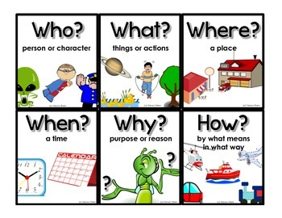
FHIM Executive Summary
Who is on the FHIM Team? What is FHIM? When did FHIM happen (chronology)?
Where is FHIM (website, repository)? Why is FHIM valuable? How is FHIM used?
Notes:
FHIM Executive Summary
Video last updated 2019-02-19. Audio Script last updated 2019-03-25.
Paragraph outline numbers correspond to automation steps.
Training Objective: “FHIM Executive Summary” training video addresses the bottom line up-front for the FHIM program Who, What, When, where, Why and How FHIM program perspectives.
The Federal Health Information Model is called FHIM.
1. Who is on the FHIM Team? You can contact the FHIM team at FHIMS 2009 at Gmail. org. In the FHIM deep dive video, the FHIM points of contact, their roles and their organizations are presented.
2. What is FHIM? Where, briefly
FHIM is a logical health information model that supports semantic interoperability and harmonizes healthcare information requirements from federal partners and standards organizations
Second, FHIM provides an integrated picture of a healthcare information model and standards information plus standard reference terminologies.
Third, FHIM has companion model driven development architectural and implementation tools. These tools help an analyst implementer or informaticist to design and develop applications using quality consistent information and requirements traceable HL7 standards such as FHIR C-CDA and V2 profiles and extensions.
Fourth, FHIM supports the specification of Electronic Healthcare Records, and serves as the blueprint for interoperable data in motion and date-ta at rest
Finally, FHIM empowers intra-agency and inter-agency interoperability plus healthcare partner, contractor, academia and industry interoperability.
3. Where are FHIM’s Collaboration Websites? Briefly,
FHIM’s https://github. com is the official government’s FHIM repository.
The www. FHIMS. org is the unofficial FHIM Team’s collaboration website, which publishes the current-version FHIM diagrams and model.
4. When were the FHIM’s Milestones? Where, briefly the key events impacting FHIM chronology started
In 2006, the George W. Bush Presidential Executive Order 13,410 established e-government lines of business, which resulted in FHA being created and its 2008 sponsoring of the FHIM.
The February 17, 2009 A-R-R-A HI-TAC legislation accelerated the creation and use of EHR systems.
It resulted in the July 13, 2010 CMS Meaning-full Use policy.
In 2015 the MACRA merit-based policies were added. .
In December 2016 The 21st Century Cures Act mandated Patient Access to their information; where,
the Cures Act defines interoperability as without requiring extra effort and without information blocking, with substantial penalties for non-compliance.
In January 2018 The US Healthcare, O-N-C Office of the National Coordinator for technology issued the draft TEFCA and US-CDI regulations; where
TEFCA defines a Trusted Exchange Framework and Common Agreement among Q-HINS, which are qualified health information exchanges managed by an R-C-E who is an ONC recognize coordinating entity
US-CDI defines the U. S. Core Data for Interoperability
The TEFCA and US-CDI policies are scheduled to be finalized in 2019.
Also In 2019, as a part of the FHA sunset, FHIM is scheduled to be transitioned from ONC stewardship.
5. Why is FHIM valuable? Concisely,
First, the FHIM delivers a vetted information view of the highly complex and ever changing healthcare land-scape.
Where, FHIM has been created, verified and validated through collaborative Modeling and Terminology meetings with the participation of federal and industry Subject Matter Experts.
Second, the FHIM provides a single point of reference to ensure consistent updating of healthcare information requirements based on changes in healthcare laws, regulations, policies, and standards.
Third, the FHIM offers the deep and consolidated meta information and tools needed in the coming years to build solutions that save cost and time and which positively impact patient safety and quality of care.
Since 2016, the FHIM team has been working with the HL7 CIMI clinical information model initiative, Clinical Quality and Decision Support, Patient Care, Public Health, devices, SOA Service Oriented Architecture, vocabulary and EHR workgroups and the HSPC SOLOR SNOMED extension for LOINC and RxNorm initiative. Collectively they have defined a holistic approach to interoperability, to better support the 21st Century Cures Act. HL7 CIMI-compliant FHIM, with SOLOR terminology bindings to improve standard and consistent shared interoperable quality healthcare data. When EHR System Functional Model referred to as EHR-S FM are mapped to FHIM to specify objects. These objects can be constructed into reusable SOA Service Oriented Architecture API application program interfaces and components suitable for service oriented platform run-time environments and user interfaces.
6. How is FHIM used?
Implementers make healthcare IT work by solving real problems. But, what are they looking for?
In about 1995, HL7 Version 3 developers claimed to have define a world in which point-to-point healthcare shared data mapping wouldn't be required.
Over 10 years of V3 usage showed that's not possible and that V3 users often have specific local use case workflow-data processing needs
Since 2010 FHIR users have said the time, complexity and cost of consistent V3 semantics is too high while not meeting their local workflow needs.
Instead, they wanted ad-hoc FHIR profiles and extension forms that are close to their domain workflow use cases.
The FHIM team appreciates FHIR’s faster-cheaper approach when it comes to customized local workflows;
where, local adaptation will often be required and HIN exchange is not required.
Here, FHIM guidence can still help make FHIR profiles and extensions more consistent.
FHIM has the goal to enable better enterprise and N-HIN Nationwide HIN interoperability
Supporting transfer-of-care and care-team management of shared patient information, such as,
Procedures, Allergies, Medications, Problems, Immunizations, Observations, Test Results and Notes.
Other FHIM Training Videos are available on the YouTube “FHIM Training Channel”.
End of the FHIM Executive Summary.
TEXT VERSION
The Federal Health Information Model is called FHIM.
This FHIM presentation follows the Journalistic Who, What, Where, When, Why and How approach.
1. Who is on the FHIM Team? You can contact the FHIM team at FHIMS 2009 at Gmail. org. In the FHIM deep dive video, the FHIM points of contact, their roles and their organizations are presented.
2. What is FHIM? Where, briefly
- FHIM is a logical health information model that supports semantic interoperability and harmonizes healthcare information requirements from federal partners and standards organizations
- Second, FHIM provides an integrated picture of a healthcare information model and standards information plus standard reference terminologies.
- Third, FHIM has companion model driven development architectural and implementation tools. These tools help an analyst implementer or informaticist to design and develop applications using quality consistent information and requirements traceable HL7 standards such as FHIR C-CDA and V2 profiles and extensions.
- Fourth, FHIM supports the specification of Electronic Healthcare Records, and serves as the blueprint for interoperable data in motion and date-ta at rest
- Finally, FHIM empowers intra-agency and inter-agency interoperability plus healthcare partner, contractor, academia and industry interoperability.
3. Where are FHIM’s Collaboration Websites? Briefly,
- FHIM’s https://github. com is the official government’s FHIM repository.
- The www. FHIMS. org is the unofficial FHIM Team’s collaboration website, which publishes the current-version FHIM diagrams and model.
4. When were the FHIM’s Milestones? Where, briefly the key events impacting FHIM chronology started
- In 2006, the George W. Bush Presidential Executive Order 13,410 established e-government lines of business, which resulted in FHA being created and its 2008 sponsoring of the FHIM.
- The February 17, 2009 A-R-R-A HI-TAC legislation accelerated the creation and use of EHR systems.
+ It resulted in the July 13, 2010 CMS Meaning-full Use policy.
+ In 2015 the MACRA merit-based policies were added. .
- In December 2016 The 21st Century Cures Act mandated Patient Access to their information; where,
+ the Cures Act defines interoperability as without requiring extra effort and without information blocking, with substantial penalties for non-compliance.
- In January 2018 The US Healthcare, O-N-C Office of the National Coordinator for technology issued the draft TEFCA and US-CDI regulations; where
+ TEFCA defines a Trusted Exchange Framework and Common Agreement among Q-HINS, which are qualified health information exchanges managed by an R-C-E who is an ONC recognize coordinating entity
+ US-CDI defines the U. S. Core Data for Interoperability
+ The TEFCA and US-CDI policies are scheduled to be finalized in 2019.
- Also In 2019, as a part of the FHA sunset, FHIM is scheduled to be transitioned from ONC stewardship.
5. Why is FHIM valuable? Concisely,
- First, the FHIM delivers a vetted information view of the highly complex and ever changing healthcare land-scape.
+Where, FHIM has been created, verified and validated through collaborative Modeling and Terminology meetings with the participation of federal and industry Subject Matter Experts.
- Second, the FHIM provides a single point of reference to ensure consistent updating of healthcare information requirements based on changes in healthcare laws, regulations, policies, and standards.
- Third, the FHIM offers the deep and consolidated meta information and tools needed in the coming years to build solutions that save cost and time and which positively impact patient safety and quality of care.
- Since 2016, the FHIM team has been working with the HL7 CIMI clinical information model initiative, Clinical Quality and Decision Support, Patient Care, Public Health, devices, SOA Service Oriented Architecture, vocabulary and EHR workgroups and the HSPC SOLOR SNOMED extension for LOINC and RxNorm initiative. Collectively they have defined a holistic approach to interoperability, to better support the 21st Century Cures Act. HL7 CIMI-compliant FHIM, with SOLOR terminology bindings to improve standard and consistent shared interoperable quality healthcare data. When EHR System Functional Model referred to as EHR-S FM are mapped to FHIM to specify objects. These objects can be constructed into reusable SOA Service Oriented Architecture API application program interfaces and components suitable for service oriented platform run-time environments and user interfaces.
6. How is FHIM used?
- Implementers make healthcare IT work by solving real problems. But, what are they looking for?
+ In about 1995, HL7 Version 3 developers claimed to have define a world in which point-to-point healthcare shared data mapping wouldn't be required.
+ Over 10 years of V3 usage showed that's not possible and that V3 users often have specific local use case workflow-data processing needs
+ Since 2010 FHIR users have said the time, complexity and cost of consistent V3 semantics is too high while not meeting their local workflow needs.
+ Instead, they wanted ad-hoc FHIR profiles and extension forms that are close to their domain workflow use cases.
- The FHIM team appreciates FHIR’s faster-cheaper approach when it comes to customized local workflows;
+ where, local adaptation will often be required and HIN exchange is not required.
+ Here, FHIM guidence can still help make FHIR profiles and extensions more consistent.
- FHIM has the goal to enable better enterprise and N-HIN Nationwide HIN interoperability
+ Supporting transfer-of-care and care-team management of shared patient information, such as,
+ Procedures, Allergies, Medications, Problems, Immunizations, Observations, Test Results and Notes.
The YouTube “FHIM Training Channel” contains related videos.
End of this Training Video.

Slide 19

Conclusions
Patient Safety, Quality of Care, Lower Cost value proposition comes from well-tested reusable FHIR APIs, SOA components and services, which are consistent and requirements’ audit-ready
Notes:
Video last updated 2019-02-19. Audio Script last updated 2019-03-25.
Paragraph outline numbers correspond to automation steps.
Training Objective: “FHIM Training Conclusions” training video restates the FHIM clinical care goal and technical objectives.
- FHIM can be useful by itself.
* FHIM can improve FHIR applicability by reducing variability and maintaining requirements traceability within Enterprises and Health Information Exchange networks.
* When aligned with the HL7 CIMI Detailed Clinical Models, and EHR System functional Model plus the HSPC SOLOR SNOW MED clinical terminology extension for LOINC and RxNorm, we can better achieve the 21st Century Cures Act TEFCA and US-CDI policies and interoperability objective. This holistic value results from faster, better, cheaper and consistent service oriented architectures, which have requirements and policy audit-ready traceability.
* FHIM-CIMI-EHRS FM-SOLAR result in reusable FHIR APIs and components which are requirements’ traceable and functional-audit ready.
* Ideally, FHIM’s data dictionary and value sets will be be curated by medical professional societies, such as HSPC Clinical Information Interoperability Council (CIIC).
- Patient Safety, Quality of Care, Lower Cost value proposition comes from well-tested reusable FHIR APIs, SOA components and services, which are consistent and requirements’ traceable.
- Your feedback and suggestions for improvement and testimonials are welcome. For questions, suggestions or to request additional information leave comments under the individual videos on the YouTube “FHIM Training Channel”.
The YouTube “FHIM Training Channel” contains related videos.
End of this Training Video.

Slide 20
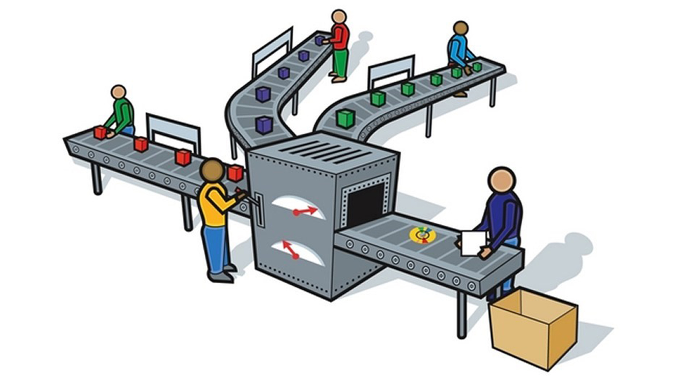

FHIM Profile Builder (FPB) Operations
Terminology
FHIM
FHIR
Implementation Guide
Use Case
MDHT Transformation

Slide 21

“FY2019 Demo” FPB Version 0. 9
Web Simple Use Case Editor
Use Case Constraints
Web API for Transformations
Via Docker
RSA Web API via Docker
MDHT
For
FHIR
STU4
FHIM UML
Storage
(RSA)
FHIR
STU4
Profiles

Slide 22
“Gold Standard” FPB Version 2 Services Vision
CDA
Profile
Services
FHIM
Services
Terminology Services
V2
Profile
Services
FPB User Interface
Translation Services
NIEM
Profile
Services
Profile
Services
FHIR
Profile
Services

